Slide 1

Libraries for everyone! Working with inclusion and accessibility in Swedish Public Libraries
Notes:
Hur många invånare i kommunen, medarbetare på biblioteken

Slide 2
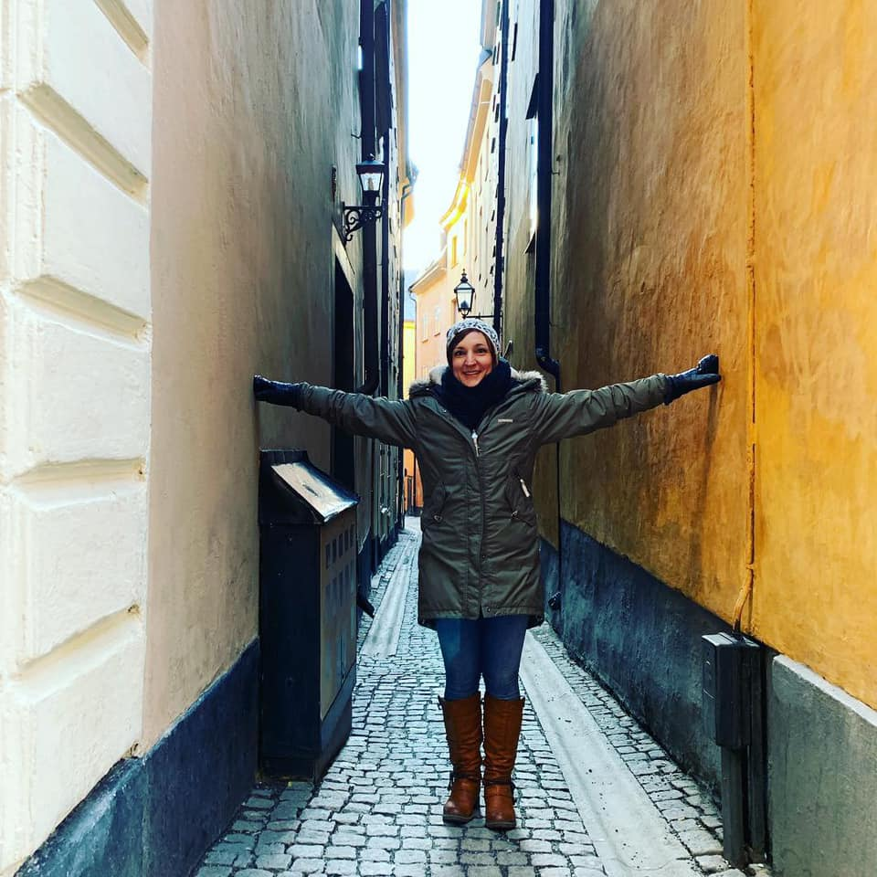
Anya Feltreuter
Library Director Mjölby Public Library, Sweden
Anya.feltreuter@mjolby.se
https://www.gotabiblioteken.se/en/web/arena/mjolby-bibliotek
Chair of the IFLA Management & Marketing Section
https://www.facebook.com/IFLA.MandM/
https://www.ifla.org/management-and-marketing
Please ask me questions! We will have time for that at the end ☺

Slide 3
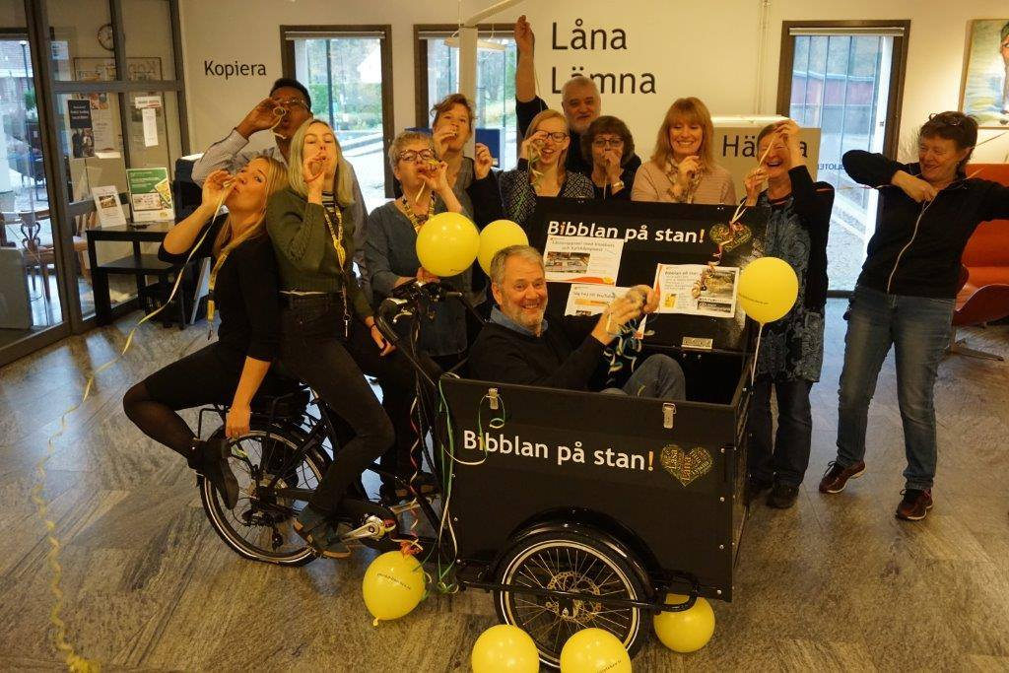
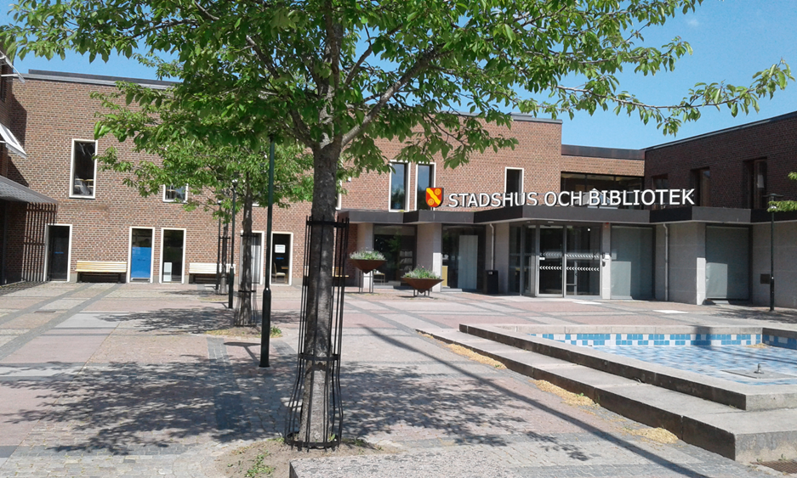
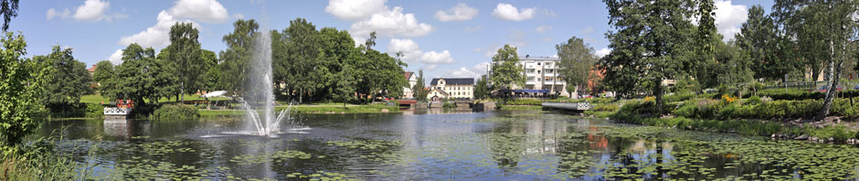
Mjölby Municipality
Ca 27 000 inhabitants
Mjölby comes from the word for mill
Skänninge, Mantorp, Väderstad and a rich countryside
Agriculture – potatoes
Toyota
Skänninge is one of Sweden´s oldest towns (1178 or older)
Railway junction
Notes:
Hur många invånare i kommunen, medarbetare på biblioteken

Slide 4
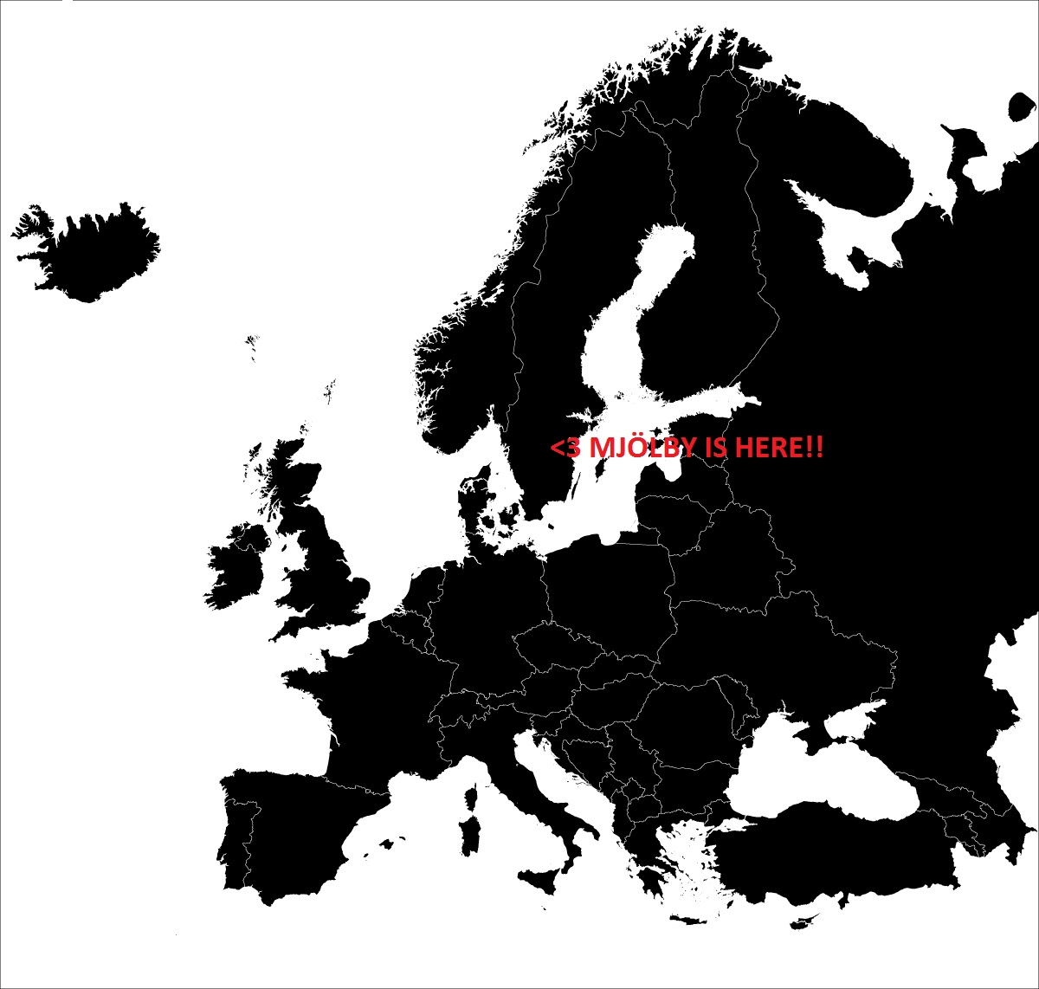
Mjölby Public Library
Mjölby Main Library
Mantorp Branch
Skänninge Branch
Väderstad Branch
The staff consists of 15-20 co-workers (not all of them working full time)
All branches are ”more open”-libraries
Library service at the Correctional Institution in Skänninge
Everything is free – all programmes, all loans
A part of Götabiblioteken – 14 municipalities in the region working together
Library on Tour - The library staff at Mjölby Public Library works extensively with reaching out to those who, for varying reasons, don’t come to the libraries.

Slide 5
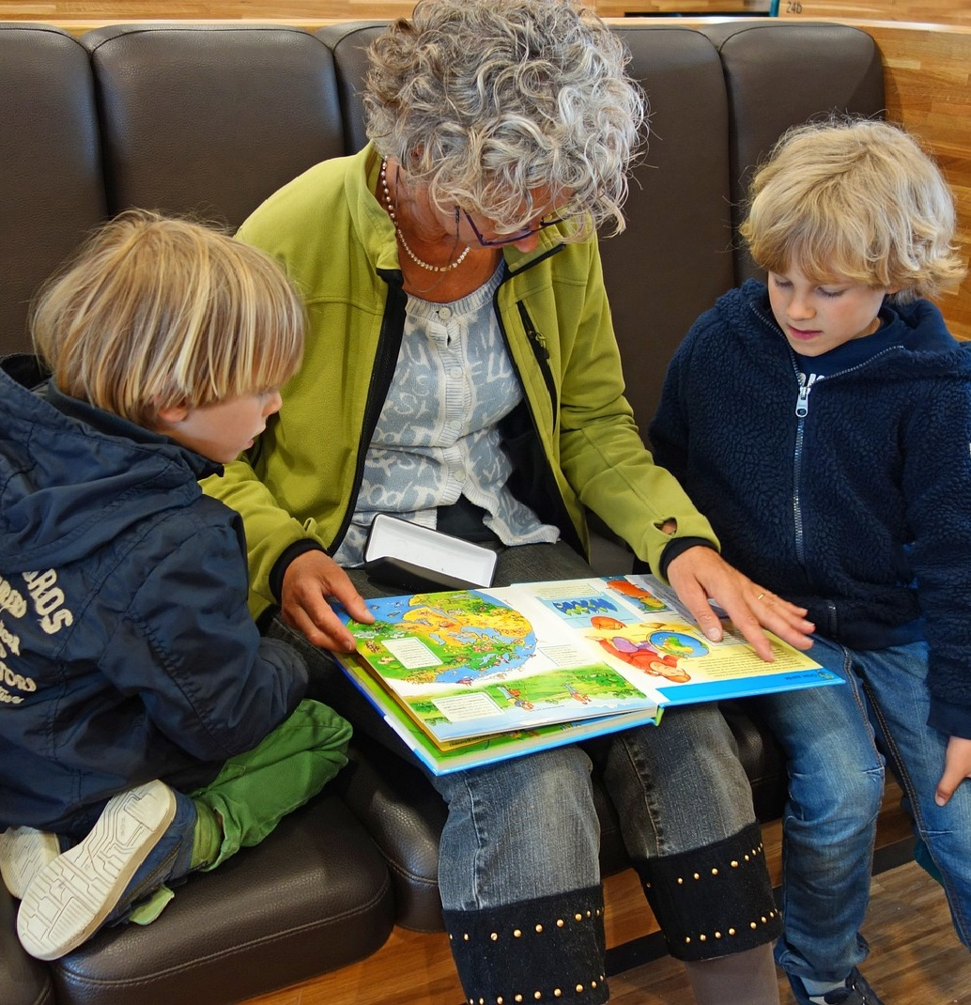
Public Libraries in Sweden
Swedish Libraries are regulated by the Swedish Library Act.
According to the Swedish Library Act [Bibliotekslag (SFS 1996:1596)], the public libraries must be available to everyone, emphasizing on the needs of children, people with functional disabilities, people speaking minority languages or a different mother tongue than the mayor population.

Slide 6

Other regulations
Swedish Law
National Library Strategy for Sweden 2019
The Global Goals for Sustainable Development
UNESCO Public Library Manifesto 1994
IFLA Global Vision & Strategy 2019-2024

Slide 7

What is accessibility?
Accessibility can be viewed as the "ability to access" and benefit from something.
It focuses on enabling access for people with disabilities, or special needs, or enabling access through the use of assistive technology.

Slide 8

What is inclusion?
Inclusion is involvement and empowerment, where the inherent worth and dignity of all people are recognized.
An inclusive library promotes and sustains a sense of belonging; it values and practices respect for the talents, beliefs, backgrounds, and ways of living of its staff and visitors.

Slide 9

Participation
It is obvoius, yet so often forgotten:
When we create services for a group we need to dicuss their needs and expectations with them.
Participation is also about creating relationships and a sense of belonging.

Slide 10

Functional disabilities
Having functional disabilities means that you have reduced capacity to function physically, mentally or intellectually.
It can be temporary or permanent.
According to the Swedish Library Act people with disabilities are a prioritized group.

Slide 11

What does Swedish Public Libraries offer?
Special services
Special events
Constantly improve accessability in our libraries and services

Slide 12
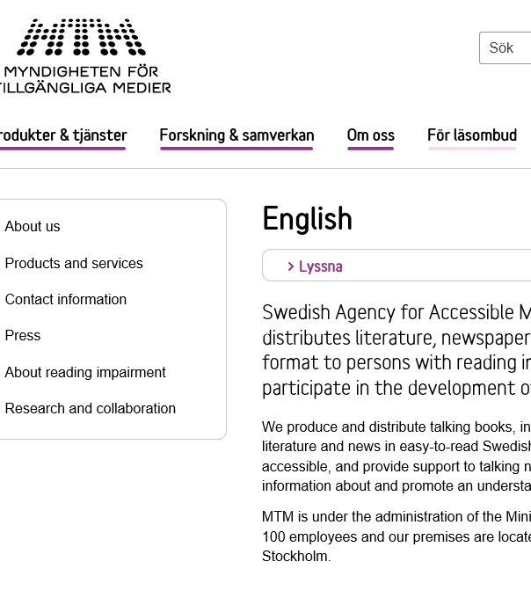
Special services
Swedish Agency for Accessible Media, MTM, produces and distributes literature, newspapers and periodicals in accessible format to persons with reading impairments.
People with reading impairments can get all printed book recorded for free as audiobooks on cd or as digital resources.
Audionewspaper – service with books and newspaper directly to your device
All libraries in Sweden must provide media in accessible formats.
Reading impairments is not only blindness or dyslexia, but can also be for example ADHD or rheumatic diseases. Reading impairments can be temporary.

Slide 13
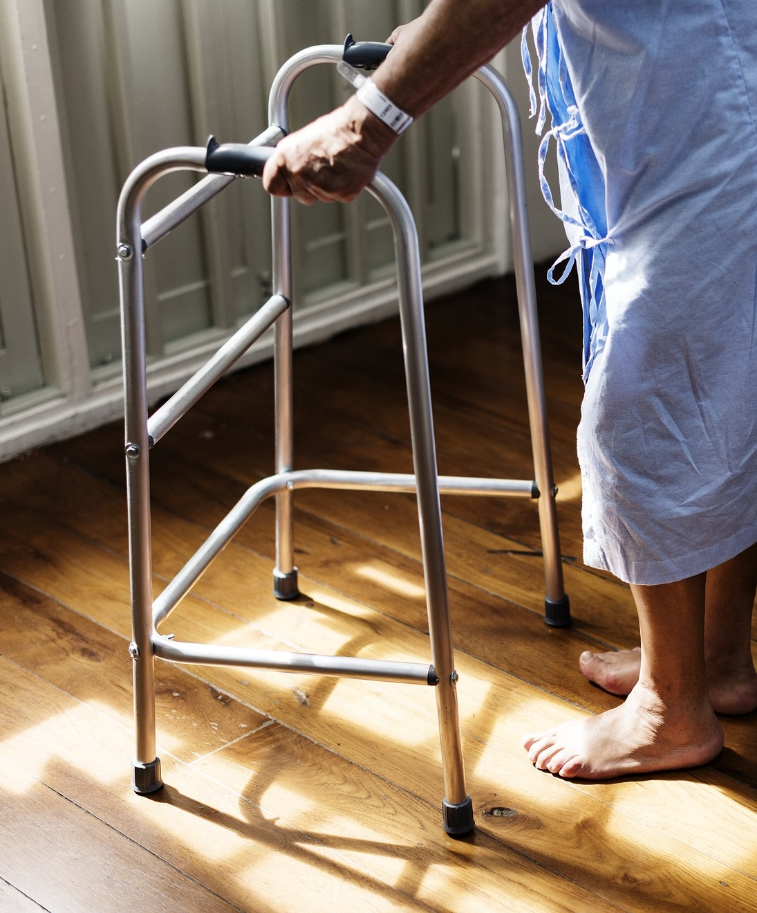
Special services
Boken kommer/Books on their way
People who are unable to visit the library get books delivered from the library.
Many Swedish Public Libraries have this service. Mjölby started this service Oct 2019
Book deliveries to retirement homes and LSS* homes or activity centers
Reading ambassadors retirement homes and LSS homes or activity centers
*LSS –the Swedish Law regulating Support and Service to Persons with Certain Functional Disabilities)

Slide 14
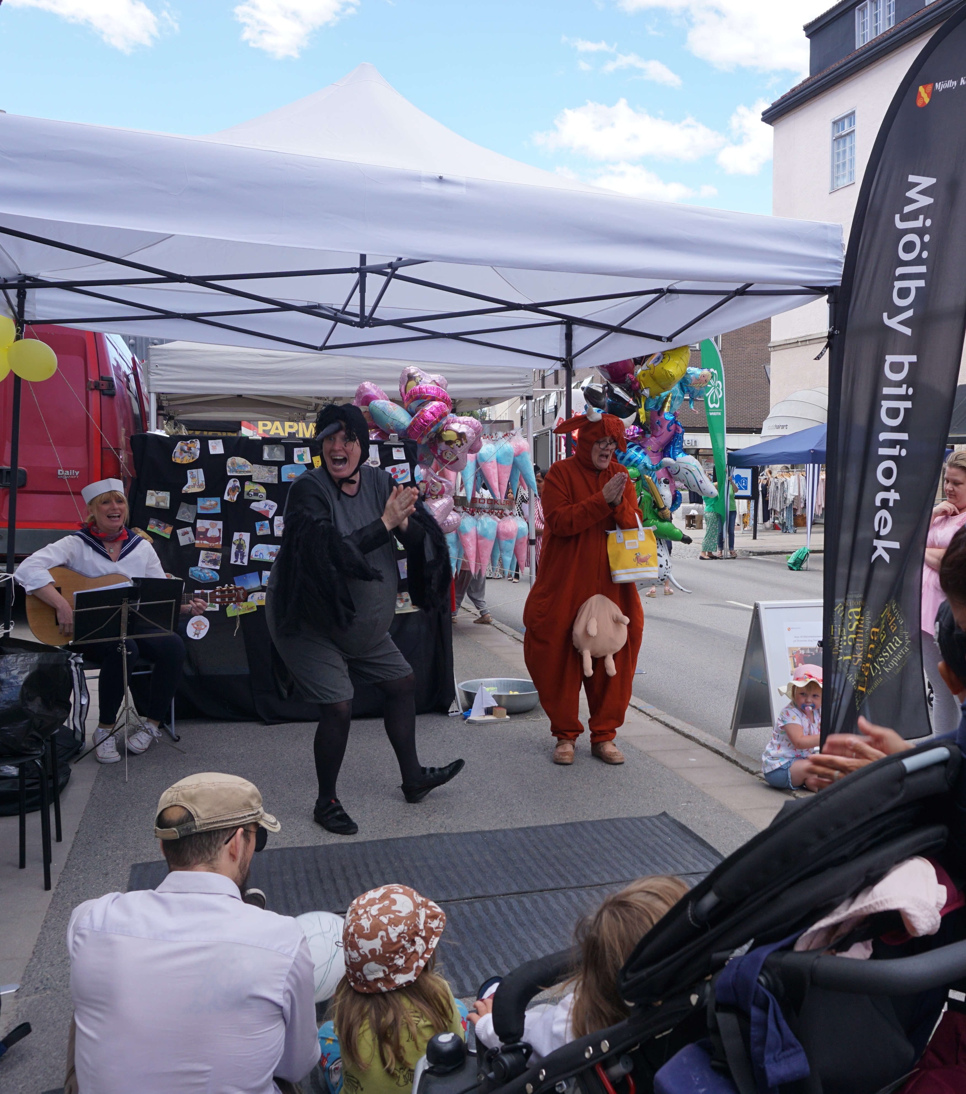
Special events
Special events for LSS* homes or activity centers – mostly something with music since it is always appriciated
Open stage – poetry
Storytimes with TAKK (Sign as support) or other storytimes/theatres that suits the target group
Special Library tours for people with special needs
Må bra med böcker/Feel better with books – a project for people with stressrelated diseases
*LSS –the Swedish Law regulating Support and Service to Persons with Certain Functional Disabilities)

Slide 15
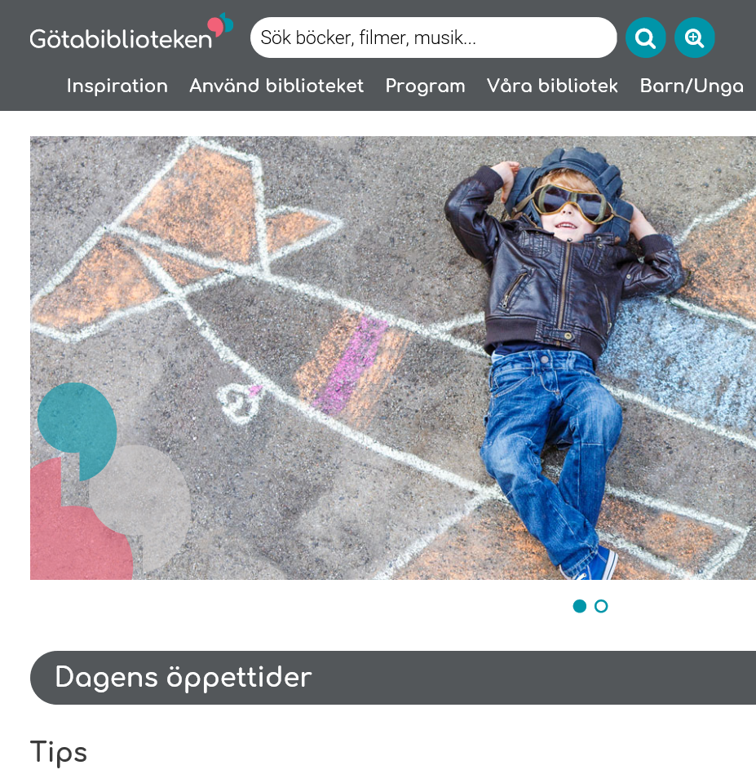
Constantly improve accessability in our libraries and services
Accessibility plan
Dicussions with local organizations and other departements in the municipality
Things we done lately:
Soap with no parfume.
Cane holders at our information disks
Improvning the signs in the library to make it easier to find what you are looking for.
Making our webpage accessable according to current standards (The Web Accessibility Directive from 2018).

Slide 16

Multi languages
Lack of language skills and knowledge about what a library is can also be a obstacle for using the services.
Sweden have a lot of residents with other mother tongue than Swedish.
People speaking minority languages or a different mother tongue than the mayor population is a prioritized group.
Sweden have 5 national minority languages: finnish, meänkieli, lappish, romani chib, yiddish (swedish sign language)

Slide 17
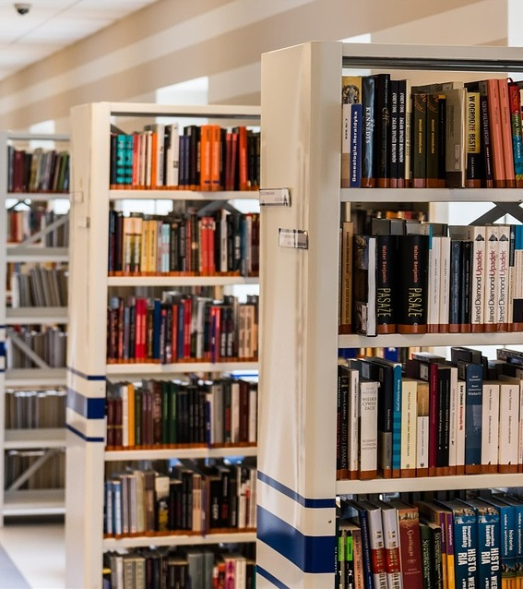
What do we offer?
Books and ”twin packages” in several languages, easy-to-read-books.
Language café and Homework café together with the Red Cross.
Library introductions for SFI (Swedish For Immigrants).
Cooperation with civic orientation held by the region.
Book club for women (and one for men) who wants to practice Swedish together with the municipals Social departement.

Slide 18
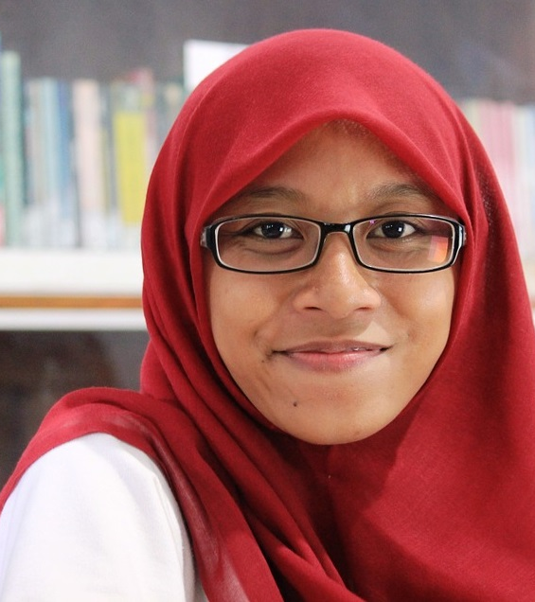
Book club for immigrant women
Learning Swedish is vital in order to become a part of the Swedish society and to get a job.
However, to start SFI (Swedish for immigrants) you must have a residence permit and be registered in a municipality – which can take years.
Even when women have a residence permit, they may have less opportunities to practice the language than men do.

Slide 19

Why doesn´t immigrant women use the library (more)?
They don't know the location of the library.
They don't know that library services are free of charge.
They feel unsure of how to use the library and find it hard to ask for help.
They don´t know that children are welcome in the library.
They want to attend language or homework café but they need to take care of children or are not allowed to leave the apartment late or go to locations where men and women meet.

Slide 20
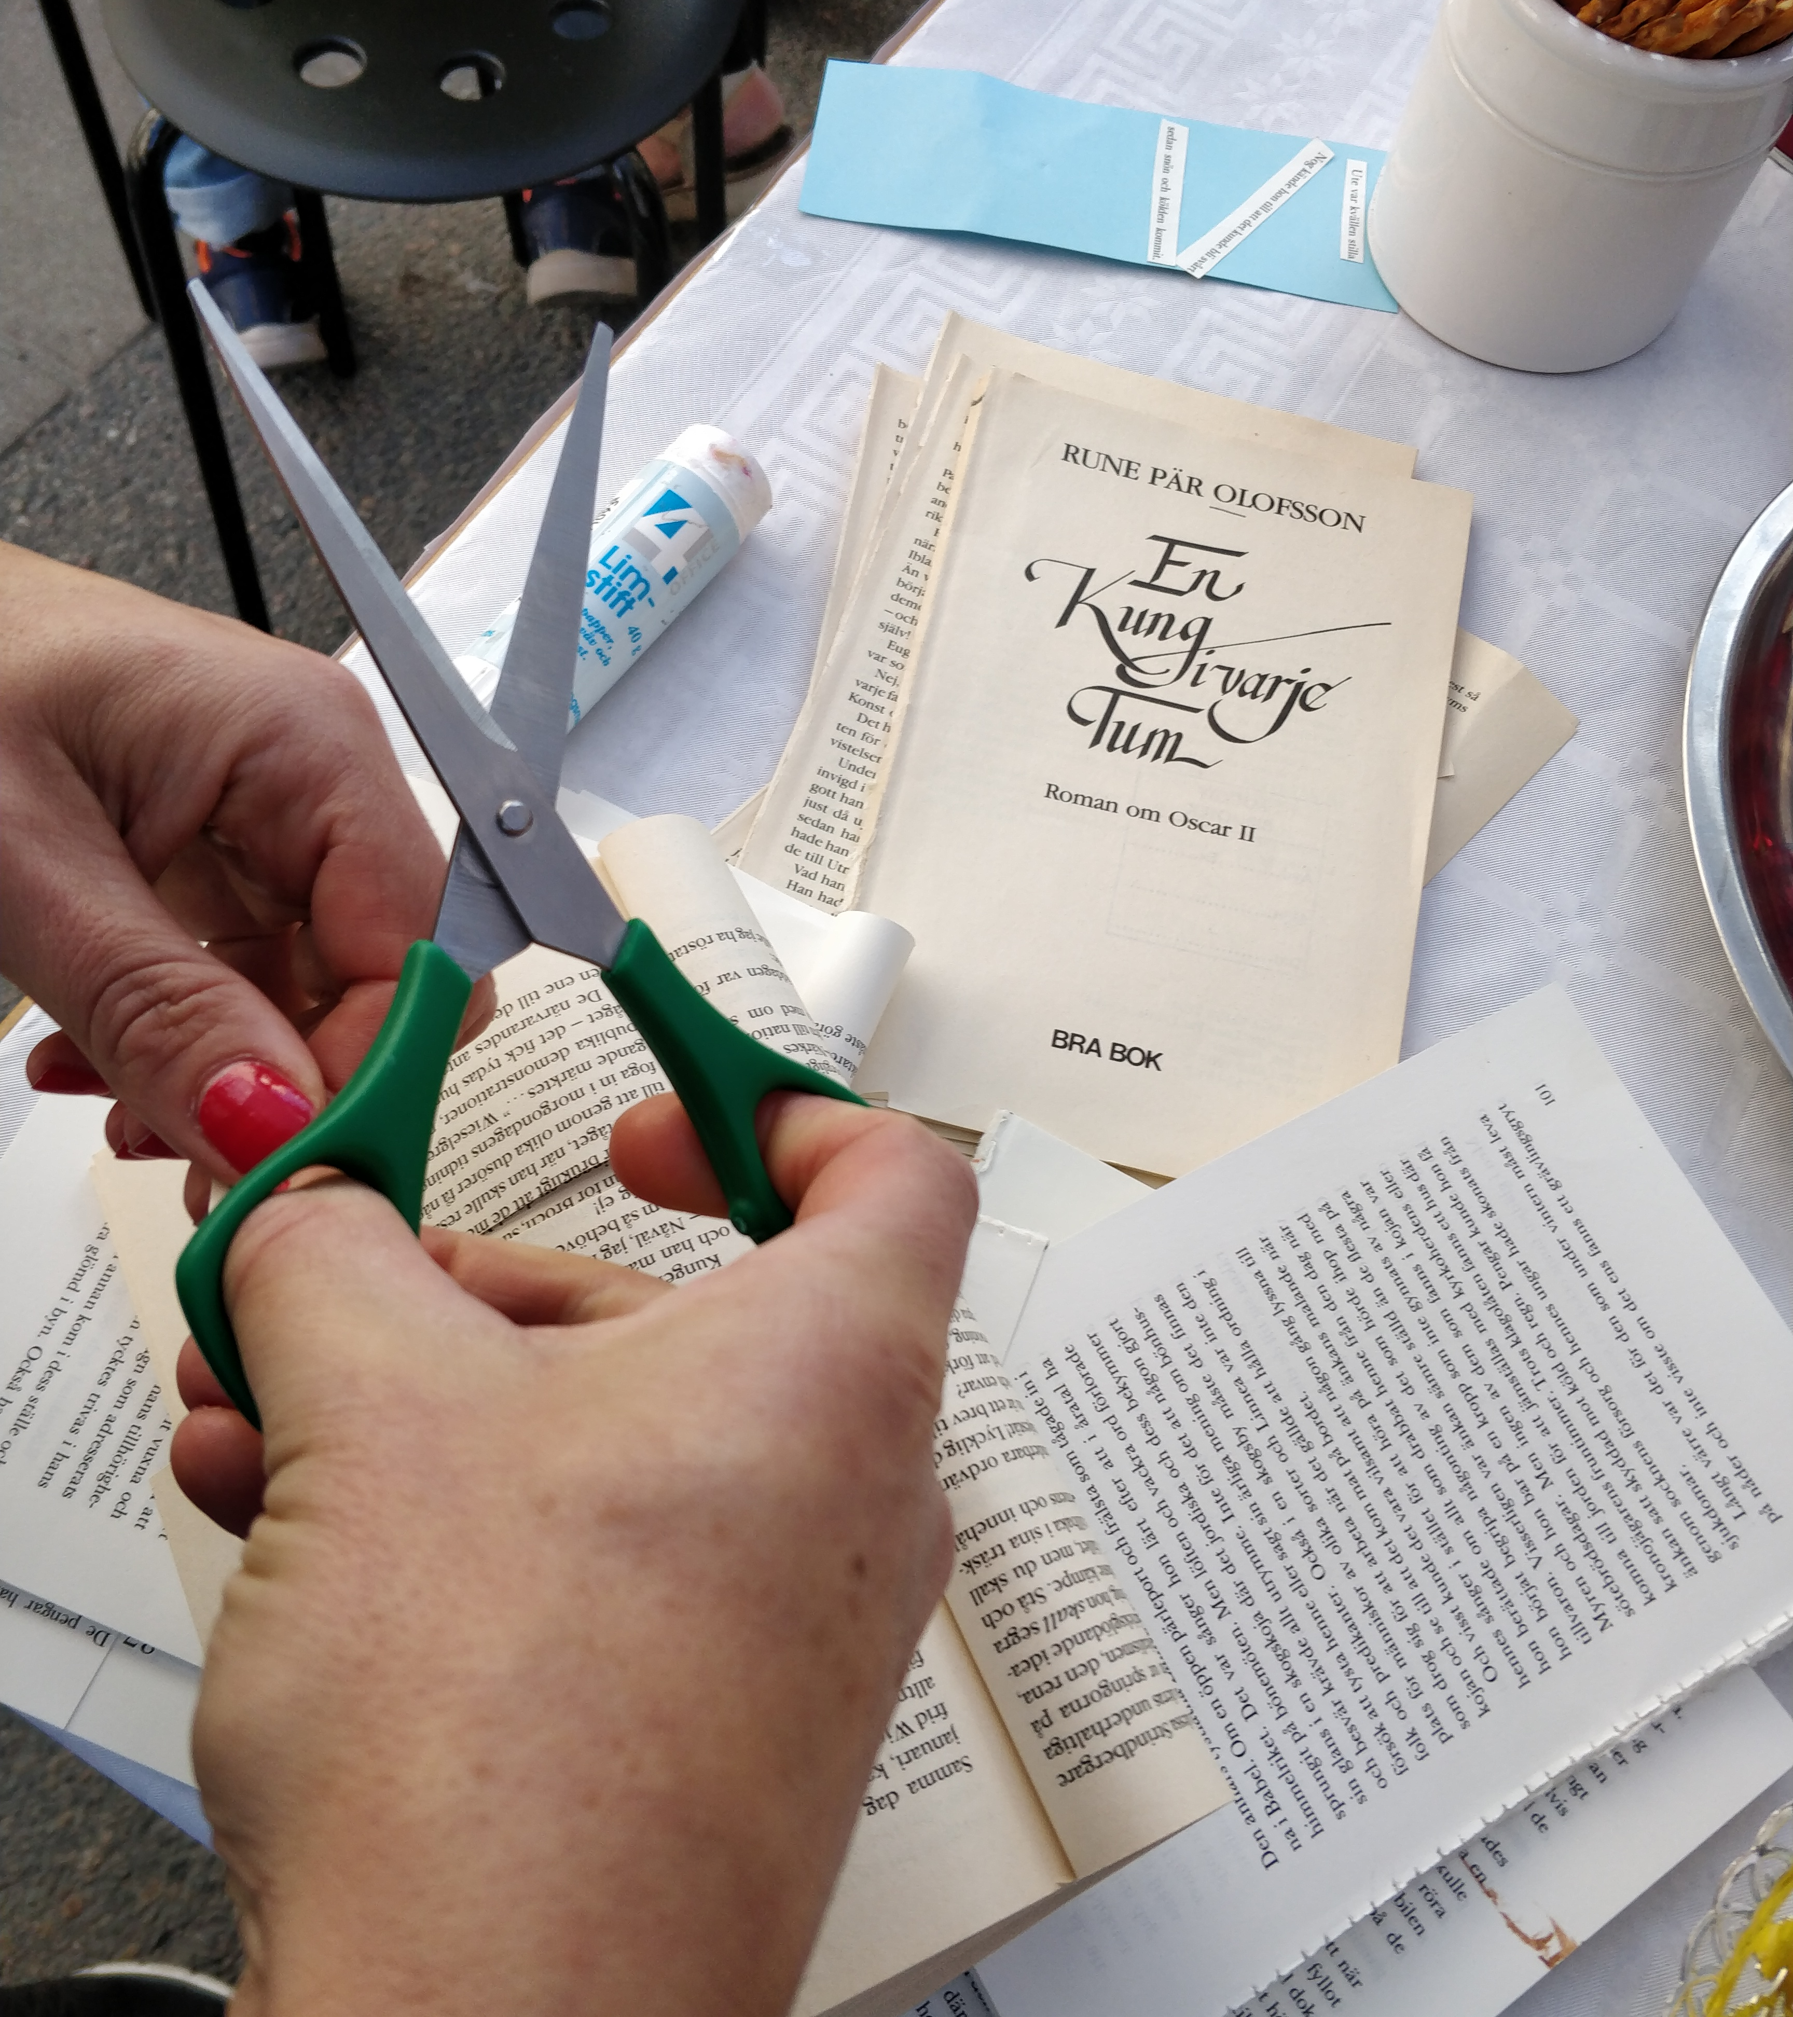
We started a book club
Women with young children can bring the children to the book club. The book club is not located at the library, but close to the SFI school and the job center.
The book club is not a traditional book club. Since all the participants are on different levels, the library staff tries to meet the particular needs of every participant.
The aim of the book club is to practice communication skills, enable discussions about the Swedish society and let participants know what the library has to offer.

Slide 21
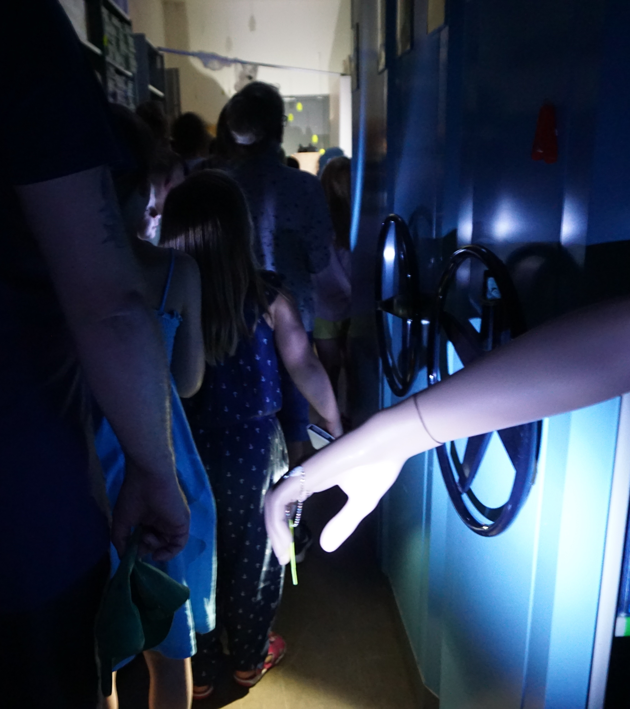
Childen and young adults
Children is a prioritized group according to the Swedish Library Act.
All Swedish Schools must have school libraries according to the Swedish School Act (but in really this is not always the case).
UNs Convention on the Rights of the Child will be part of Swedish legislation from January 2020 https://www.unicef.org/child-rights-convention/what-is-the-convention
Activities for children all year around.

Slide 22
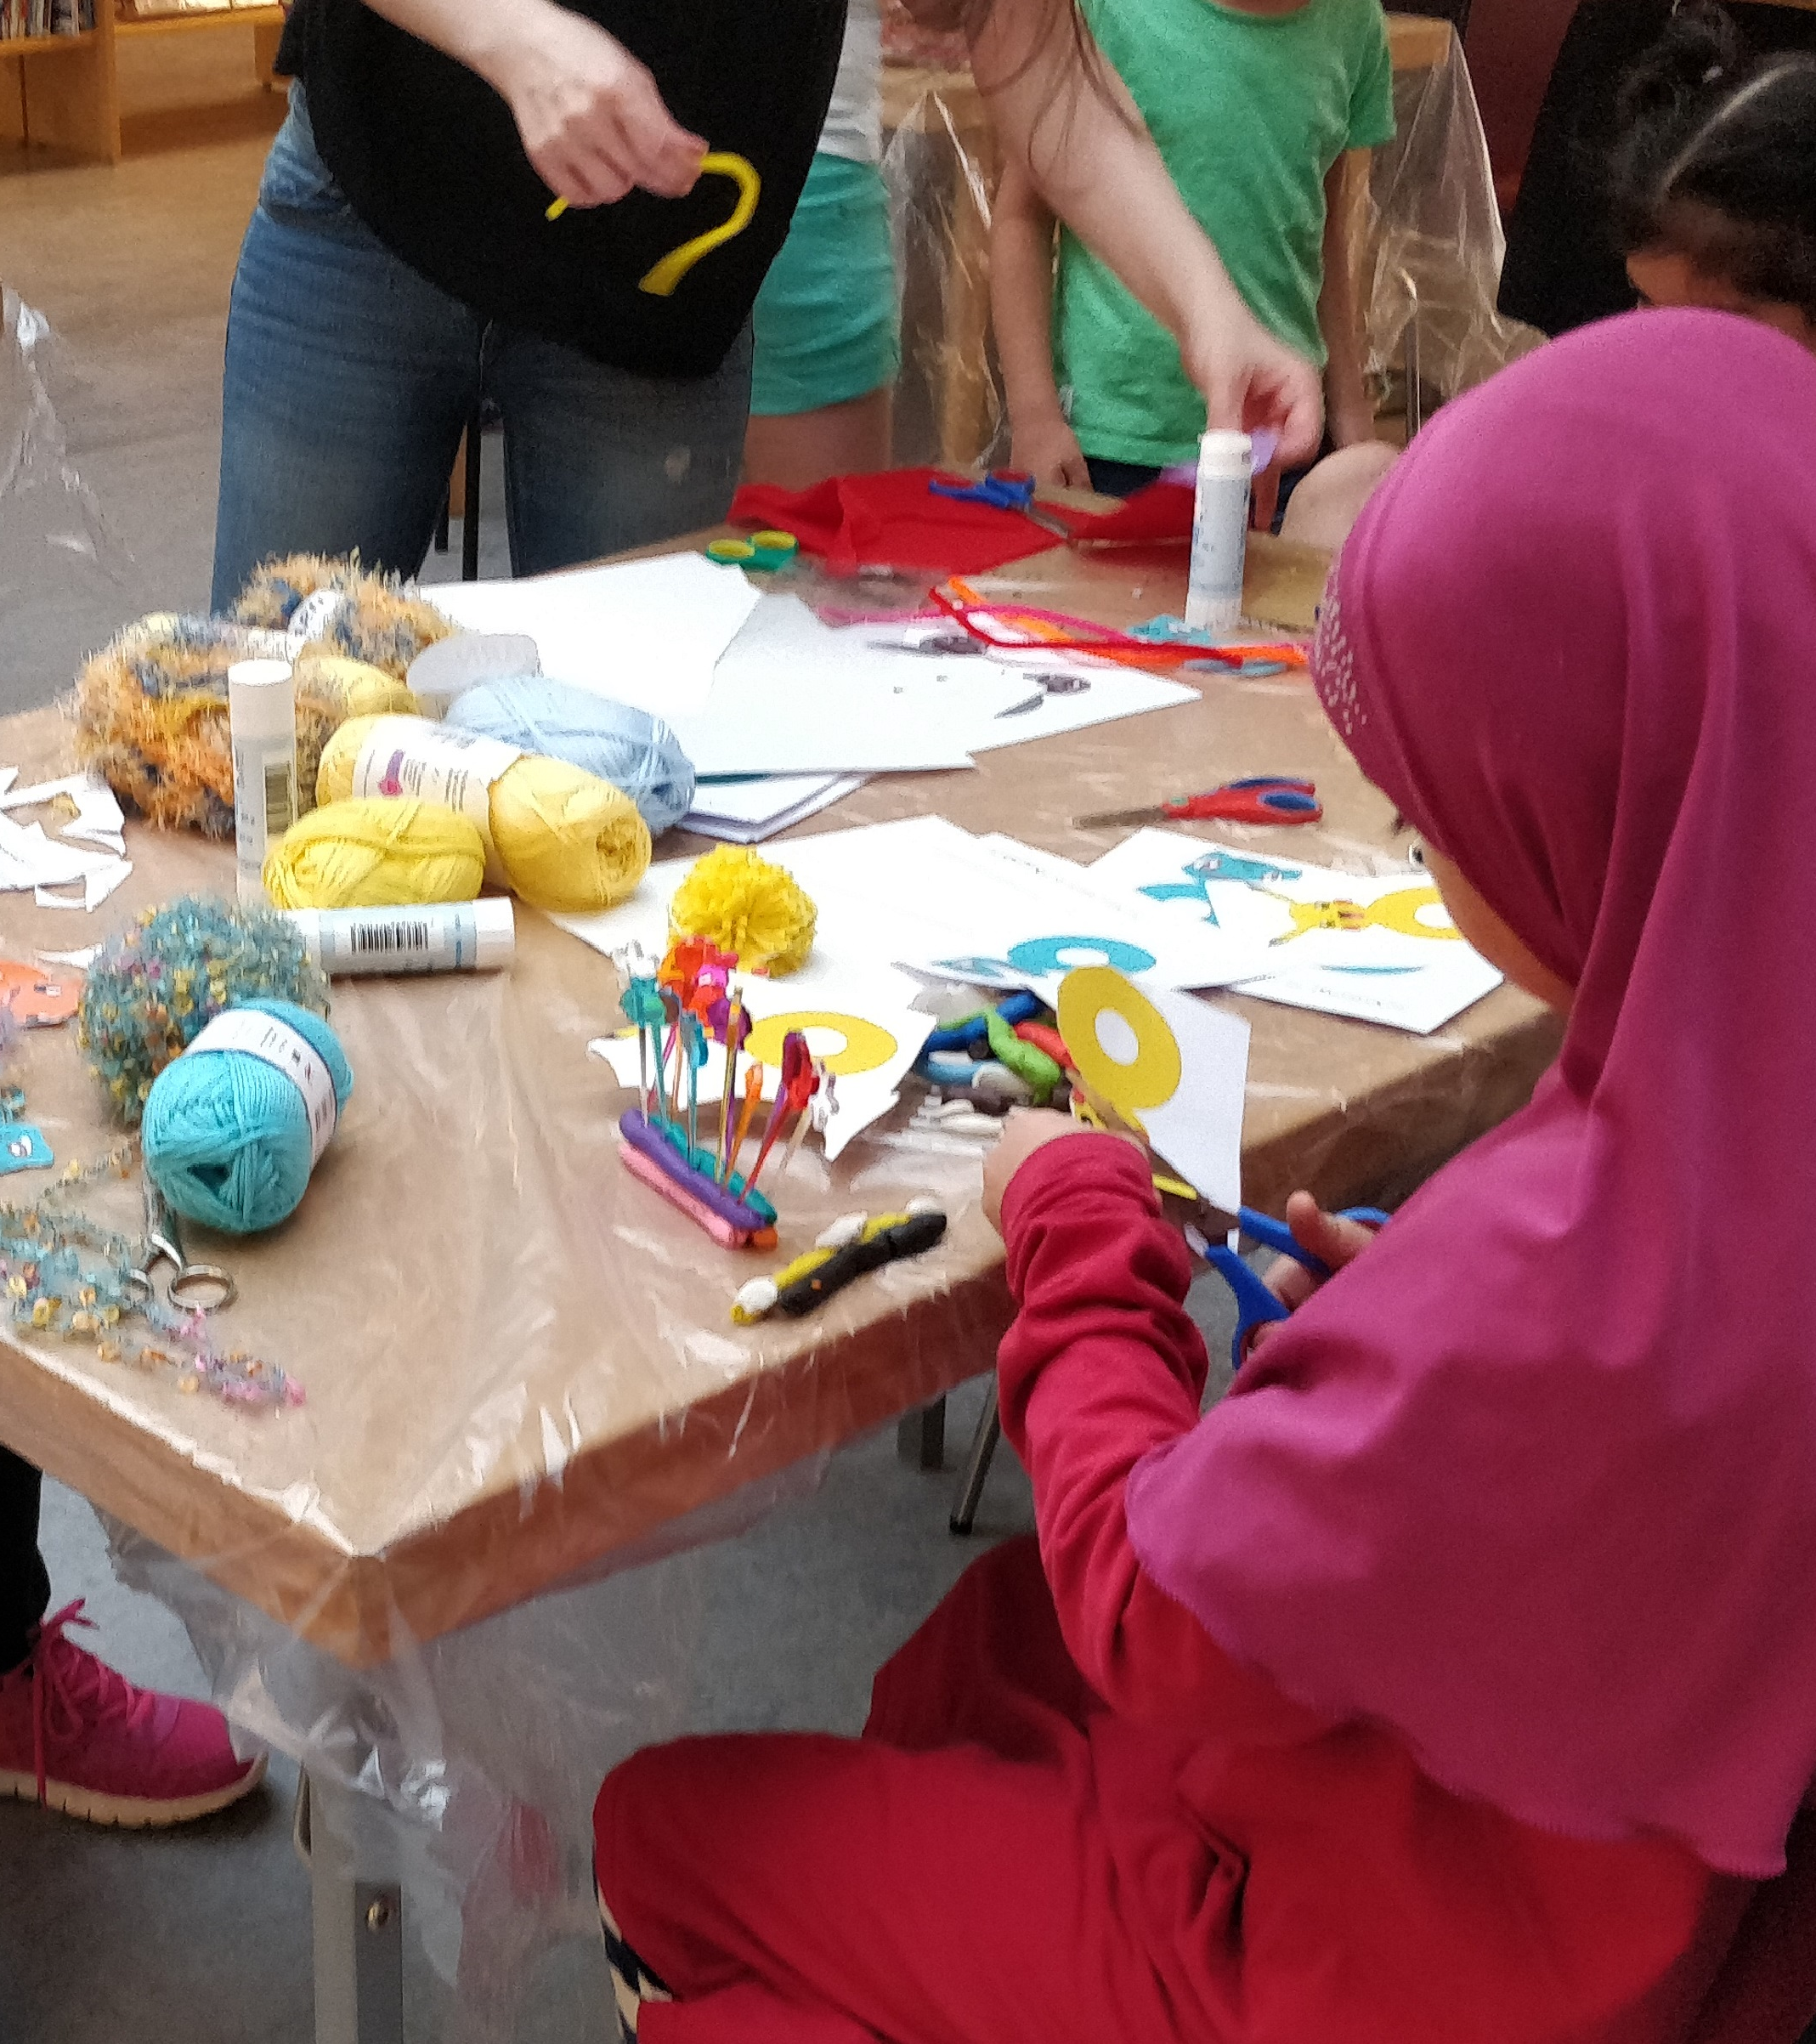
What do we offer childen?
Books, e-books, movies, TV-games, audiobooks
Saturday fun – every Saturday at the main library! Always for free, no booking needed. Saturday fun can be storytimes, crafting, makerspaces…
Activities on school holidays: makerspaces, writing/creating, yoga, storytime, authors, youtubers…
Boardgames, computers, funtable.
Cloakroom-libraries in kindergardens.
Projects together with classes.
Secret Society – book club for youth.
Activities in city center or residental areas.

Slide 23
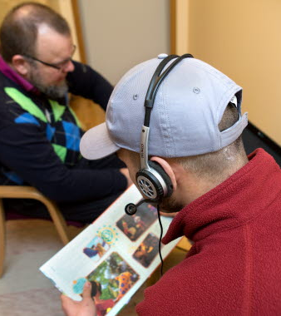
Correctional Institution & Fairytales from inside
Library service to the Correctional Institution 2 days a week.
Inmates can borrow books and audiobooks
Fairytales from inside is a project were inmates, who are fathers, are trained to read loud to their children
The inmates gets to record a cd to send to their children

Slide 24

Mjölby Pride week 2019
Mjölby Pride Week is an ”underground inititative” ☺
The idea came from librariy staff and from the social workers working on the field with youth.
Cooperation with organizations, other parts of the municiplaity.
11th of Nov – 16th of Nov 2019
The aim is to highlight that all humans have equal rights and should have the same possibilities regardless sexuality, gender or sexual expression.

Slide 25
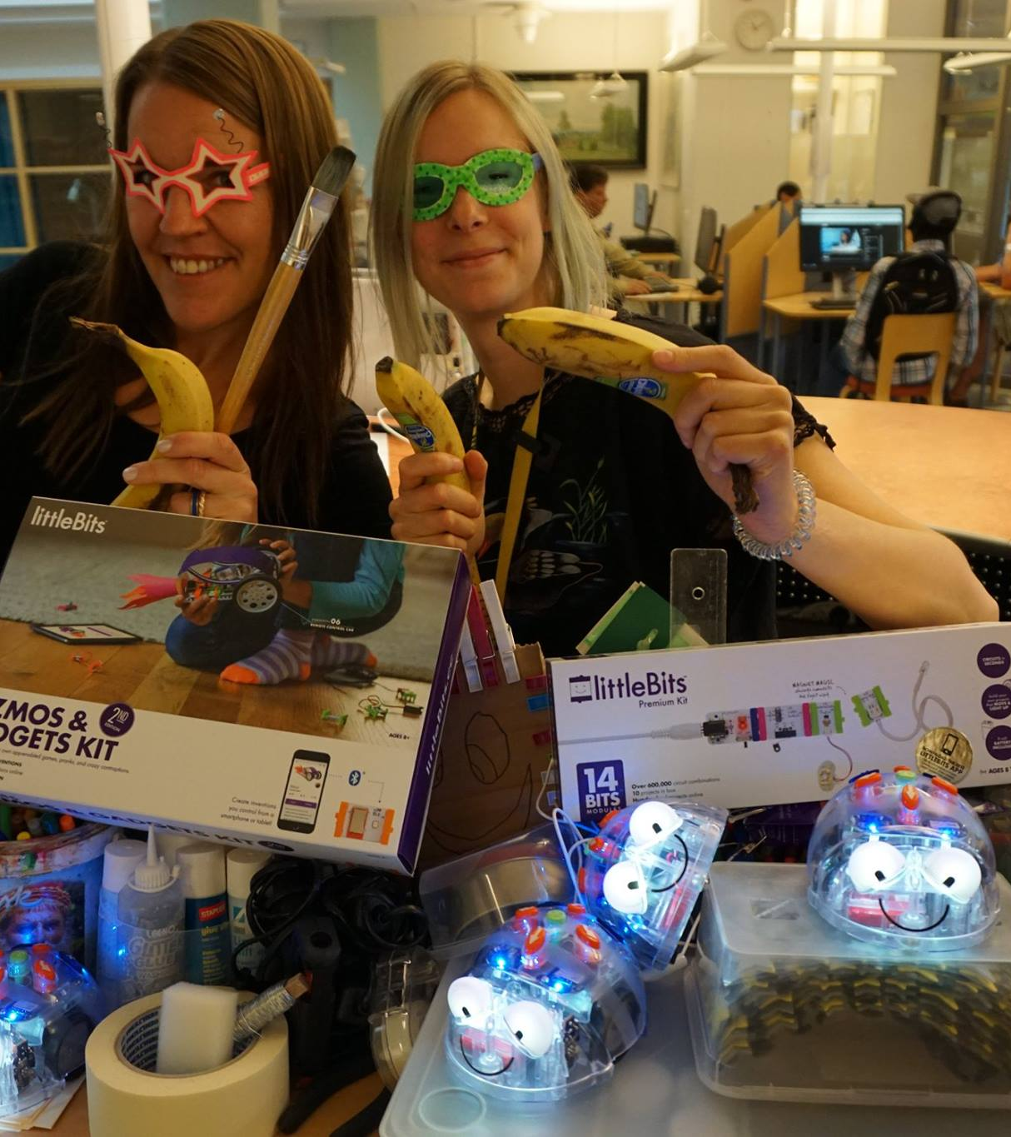
Digital inclusion
Mjölby public library works with digital inclusion for all ages.
We have digital first aid every week at our Libraries in Mjölby, Skänninge and Mantorp.
Lectures, courses (always free!).
Book a librarian!

Slide 26
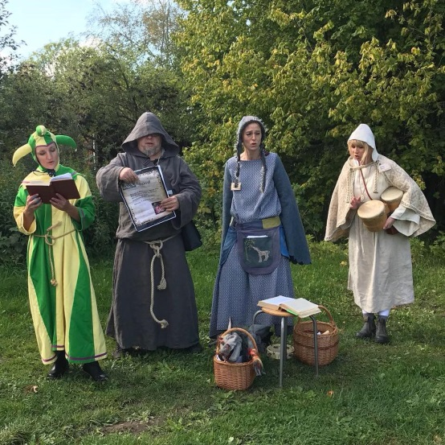
Questions?
Please keep in contact!
Anya.feltreuter@mjolby.se
I enjoyed visiting Lithuania
and would love to go back!

