Slide 1
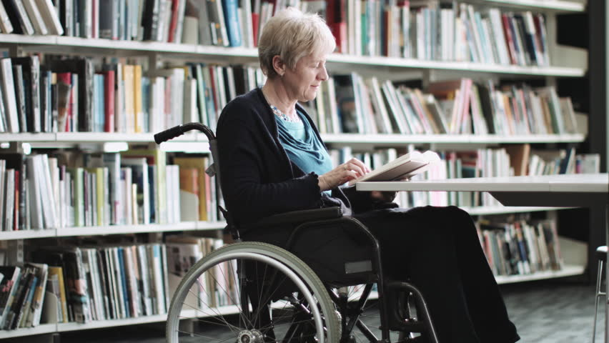
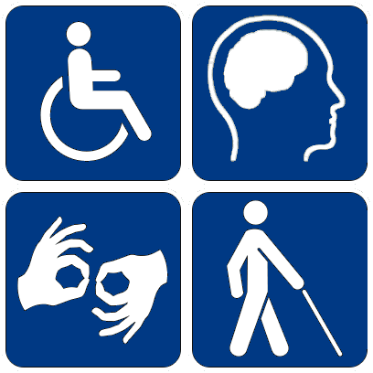
LIBRARY FOR ALL!
THE ROLE OF THE LIBRARY IN BUILDING AN INCLUSIVE COMMUNITY-
PROGRAMS AND SERVICES FOR PEOPLE WITH DISABILITIES
Belgrade City Library and Serbia examples
Jasmina Ninkov Belgrade City Library

Slide 2
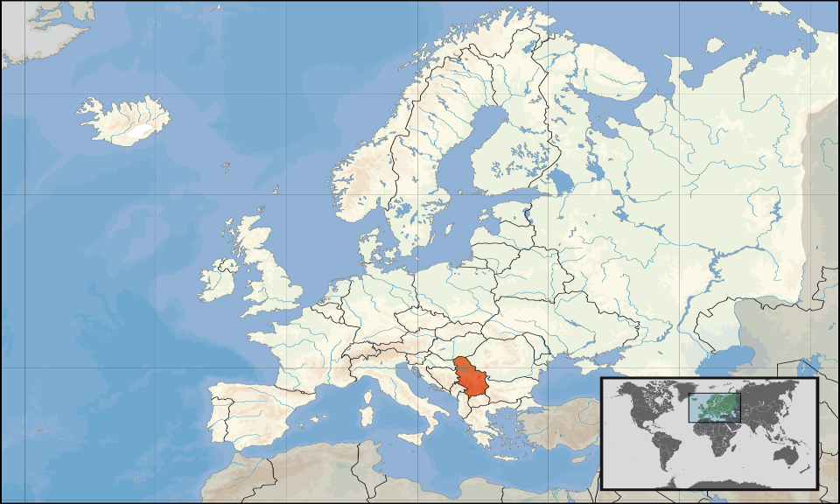
Serbia

Slide 3
SERBIA
Position: Europe, South-East
Area: 88.361 km²
Population: 7.498.000
Capital: Belgrade
Notes:
3

Slide 4
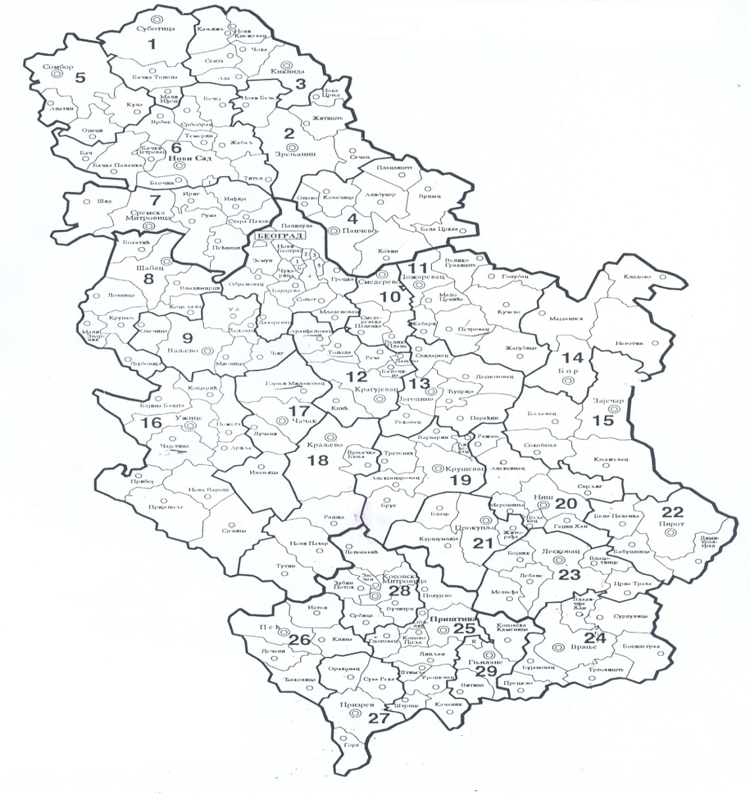
Overview of public libraries in Serbia
SERBIAN LIBRARY NETWORK
Facts and Figures
Library Type Number
National 2
Academic 214
School 1553
Special 267
Public
(branches included) 564
TOTAL 2600
548.079 members
(233.475 children, 314.604 adults)
1994 library staff
13.934.530 books
61.509 serials
545.887 non-book material
Associations
Serbian Library Association
Parent Library Community of Serbia

Slide 5

Overview of public libraries in Serbia
LEGISLATIVE
Basic Laws
Li­bra­ri­an­ship and In­for­ma­tion Ac­ti­vi­ti­es Law (2012)
Legal Deposit of Publication Law (2012)
Old and Rare Book Law (2012)
Followed by 16 subordinate documents (2012)
Side Laws
Copyright Law
Data Protection Law
In­hi­bi­tion of Di­scri­mi­na­tion of Di­sa­bled Law
…
The most important provision:
“Establishing the public library in each municipality is mandatory by the force of the Law”.
CC BY-NC-SA

Slide 6

Overview of public libraries in Serbia
Parental Functions
Development of the library network
(statistics,
instructions and trainings,
inspection,
analysis,
central register of libraries,
workplace learning and
system improvement measures)
Centralized activities of importance for the network
Union Catalogue
Coordinated Digitization
State purchase of books
CC BY-NC-SA

Slide 7
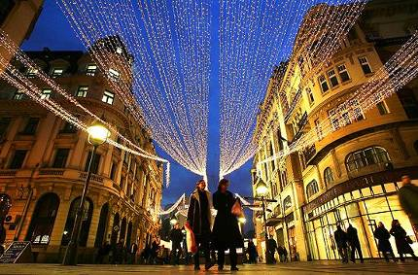
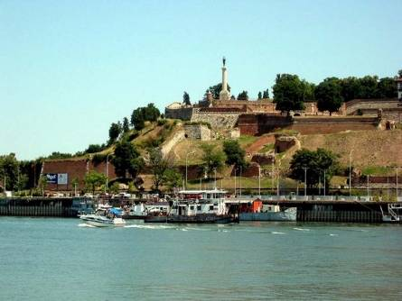
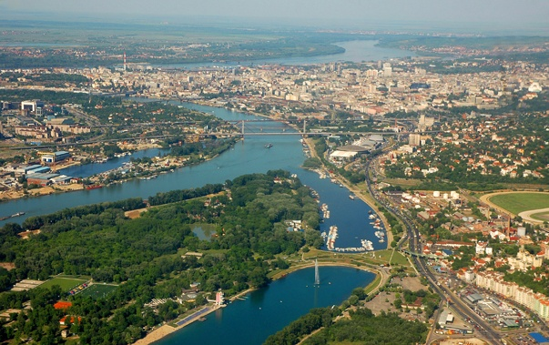
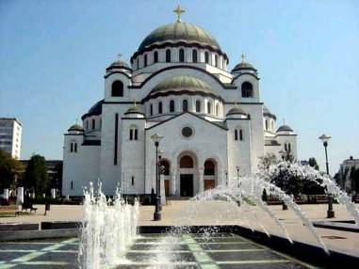
Belgrade

Slide 8
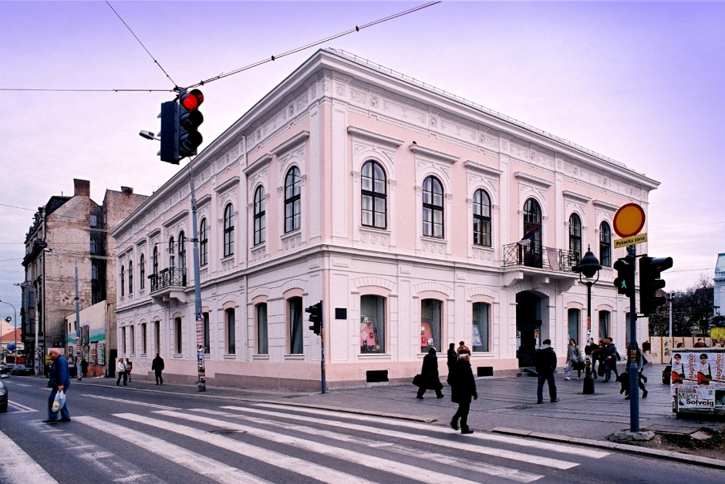

The Belgrade City Library - Central building
The Library has 76 facilities: 1 central building with 7 dislocated facilities, 14 municipal libraries with 53 branch libraries, and 2 separate children's departments.

Slide 9
Jasmina Ninkov, Belgrade City Library
BELGRADE CITY LIBRARY
The biggest public library in Serbia
Area – 13.000 m²
Collection – 1.8 million vol.
Patrons – 155.000
Notes:
9

Slide 10
Belgrade City Library
Network of 14 municipal libraries
12 departments
275 employees
Over 70 locations throughout the City
About 2 milion books and other materials
Founded in 1931.

Slide 11
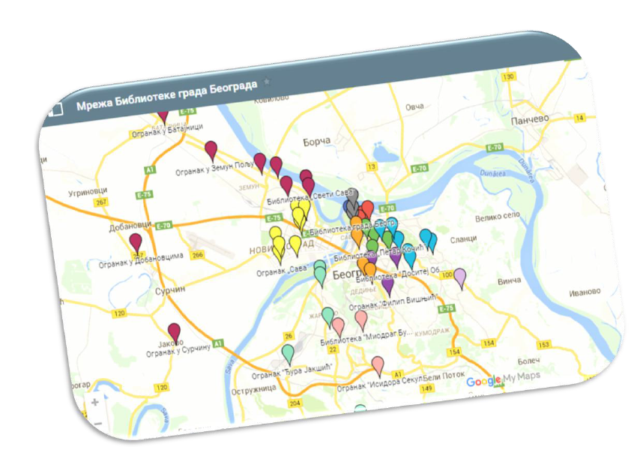
BCL Network

Slide 12
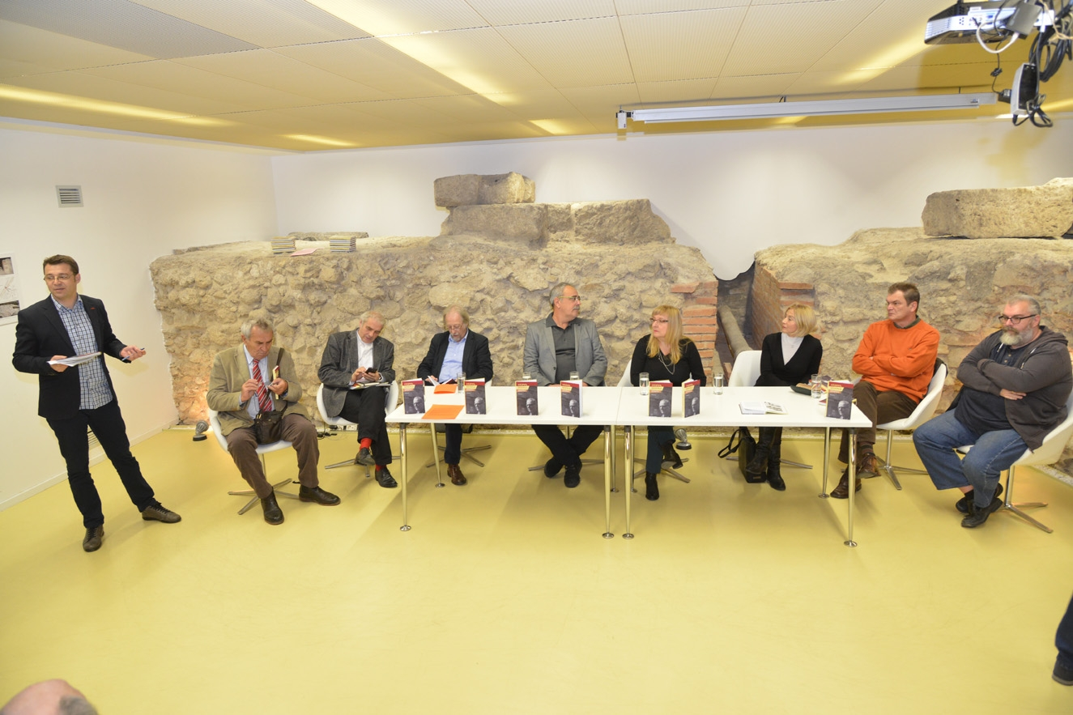

Slide 13
Cultural programs
3500 cultural programs
Gallery
American corner
Program with children
projects

Slide 14
IT inclusion
The project was based on research of our marketing department
270000 people older than 65 lived in Belgrade
Only 10% is member of the library
Waiting list for the course is always full
Trainers are librarians
We produce the book
Our older members now come more often and use online resources for information and correspondence with their friends and family worldwide. BCL will build on its success in reaching underserved patrons and will continue the project in future years...

Slide 15
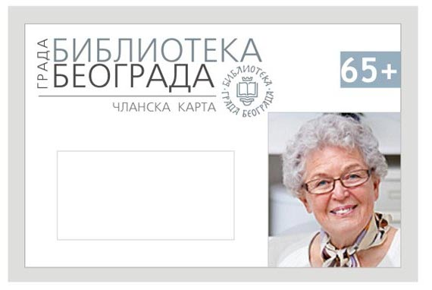
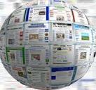
IT inclusion project 65 plus
In 2010, Belgrade City Library (BCL, Serbia) introduced the project "65+" to reach a notable group of patrons who were not receiving services. The project was intended for citizens over 65 and included a new category of free permanent membership, followed by free computer literacy courses and a book "IT for beginers: practicum for 65+" for each trainee

Slide 16
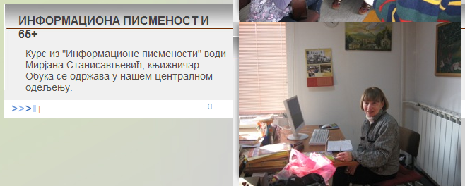
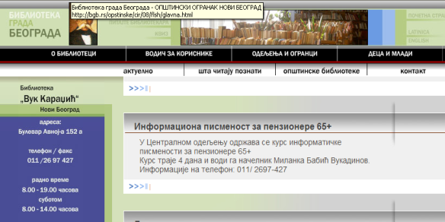
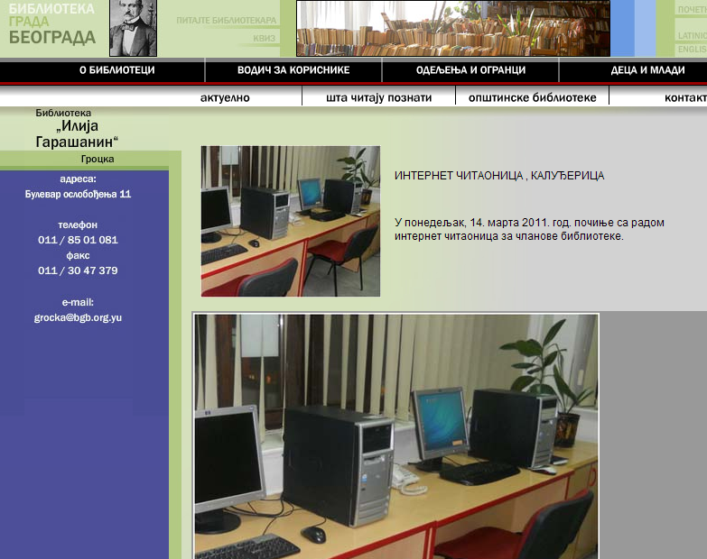
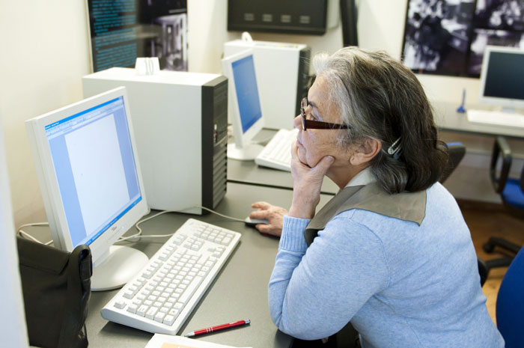
LLP

Slide 17
Disabled people
The issues regarding access to information held by or provided through public libraries for disabled people who have difficulty using facilities provided for the general public, This includes people who are temporarily disabled, e.g. through accidents, as well as those with age-related disabilities.
The term physical impairments refers to reduced mobility, reach, balance, stamina and/or height. Sensory impairments include reduced vision and/or hearing. The term ‘print-disabled’ also covers people with a visual, mental or physical impairment as well as dyslexic persons who encounter difficulties reading conventional print.

Slide 18
IST
Disabled people are a major target in all dimensions of e-Inclusion. IST are especially promising for disabled people as they can assist them in using facilities
Services provided by public libraries, their accessibility and suitability for disabled people, can be categorised in four main areas:
physical access (to buildings, service counters, workstations, reading rooms, shelves etc);
intellectual access (to the content of information carriers, including the availability of alternative format materials, adapted workstations and special software);
training for library staff members in helping disabled people;
virtual access (to provide access to library services for those not able to visit the actual building. This can include visits to housebound people by volunteers as well as digital access).

Slide 19
Disabled people are potential customers and must be taken into account if public libraries are to remain competitive. As the European population ages, increasing numbers of older people will develop visual or other impairments. Public libraries in Europe are running the risk of excluding 10% of Europeans as potential clients unless specific steps are taken.

Slide 20
Areas for improvemenT
Firstly, physical access should be made possible for every member of every community, from those with a (temporarily) reduced ability to walk or orient themselves to those who require the use of a wheelchair.
Secondly, libraries must be able to guarantee intellectual access by supplying materials in alternative formats or by providing special technical equipment, in order to make print publications accessible for people with visual or reading impairments and learning difficulties.
Thirdly, a culture of disability awareness must be developed with library staff having an effective understanding of the needs of disabled people. Disability awareness training should be an integral part of the initial education of librarians and should also form an element of ongoing staff training.

Slide 21



Why?
We are an imperfect world, same in diversity
They have the right to fully participate in the community
Right to socialization, acceptance, recognition, self-esteem, cognitive and aesthetic needs
To accept the library as an ideal place for learning, playing, education

Slide 22




WHY LIBRary?
Social responsibility
Public service for community
Library for everyone
Ethics of equal access
Reader friendly to user friendly
To offer them interactive programs that will help them to use existing skills and to develop their potential

Slide 23

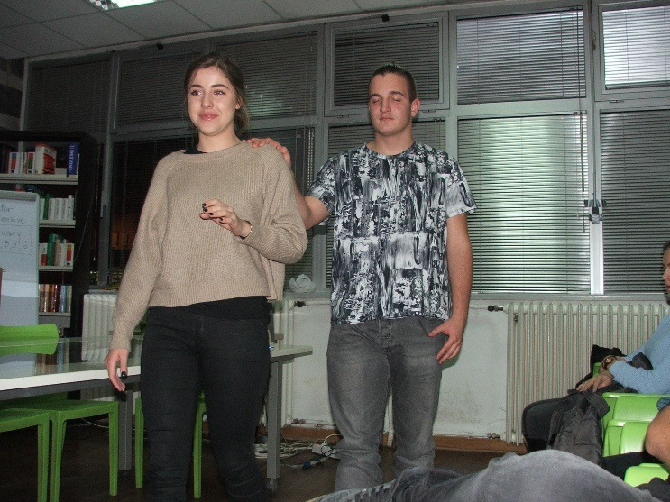


BEGINNINGS
Limited experience and knowledge about characteristics and problems of people with disabilities
Surveys, researches, statistics, interviews with experts, medical staff
Training: defectology, psychology, pedagogy

Slide 24

Reaching out
Contacts with organizations and associations that deal with people with disabilities
Suggestions and solutions

Slide 25
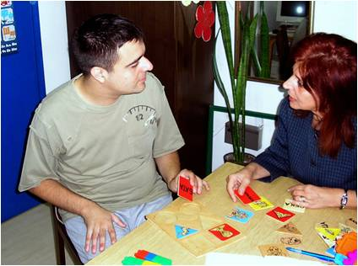
Acceptance
Introduction
Communication starting

Slide 26
2010
Belgrade City Library
Faculty for Special Education and Rehabilitation
Veljko Ramadanovic School for Students with Visual Impairment, Zemun
School for Children with Intellectual Disabilities,
New Belgrade

Slide 27
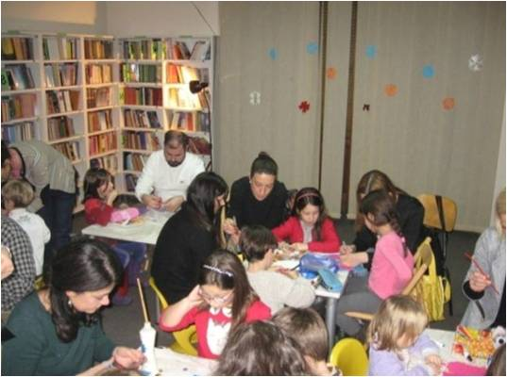
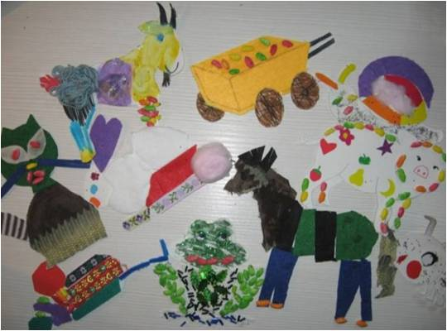
The project : educational and creative workshops for children with disabilities
Workshops
  Children's rights
  Ecology
  Acting
  Art

Slide 28
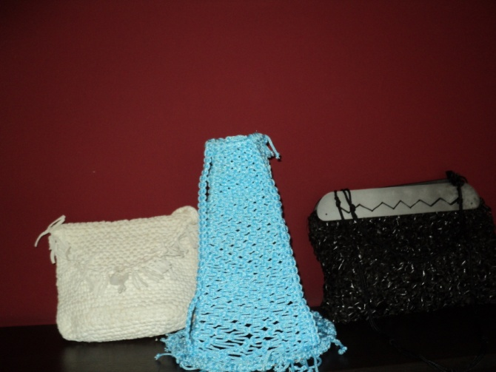
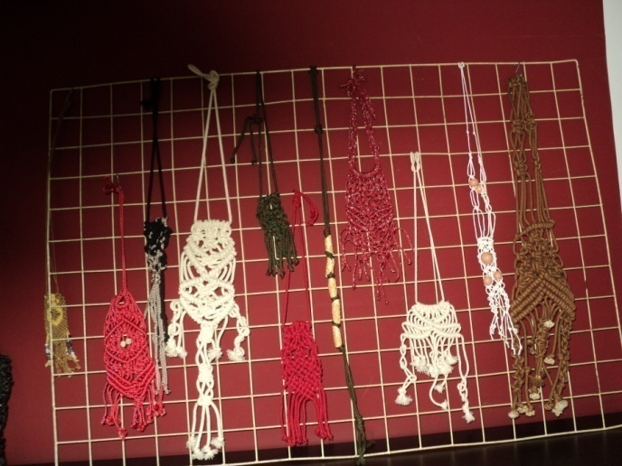
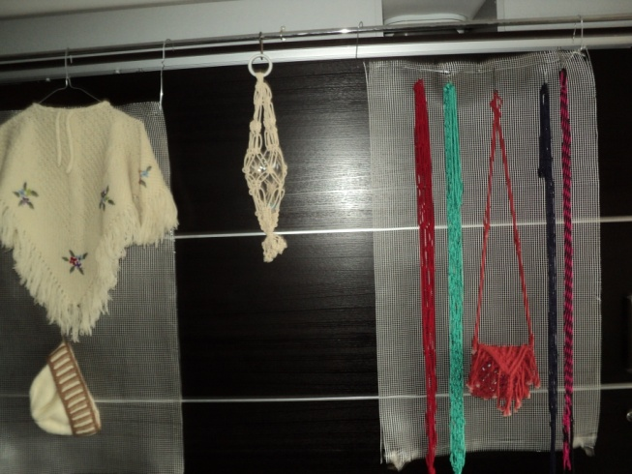
LIBRARY „PETAR KOČIĆ“, Vračar, and ASSOCIATION FOR THE BLIND AND VISUALLY IMPAIRED
Promotion of active and equal life
Promotion of culture, sport and art activities

Slide 29
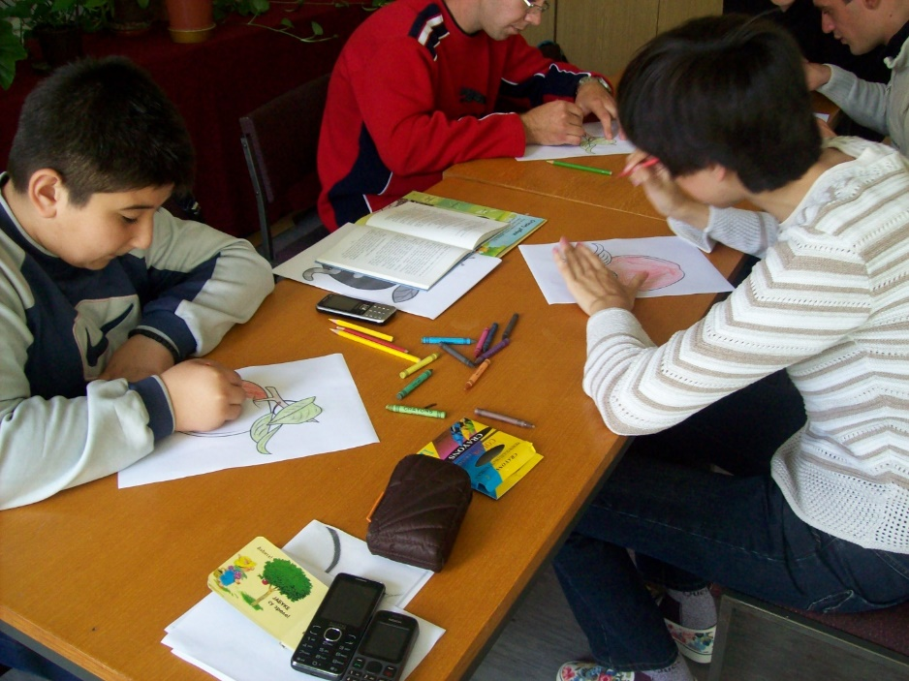
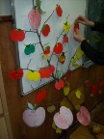
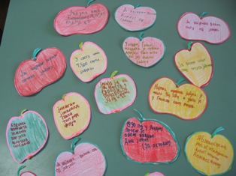
LIBRARY “MILOVAN VIDAKOVIĆ”, Sopot, and HUMANITARIAN ASSOCIATION "CHILD CARE", Sopot
Workshops Library for all
Poetry reading
Apple Day
Drawing
Recitals

Slide 30
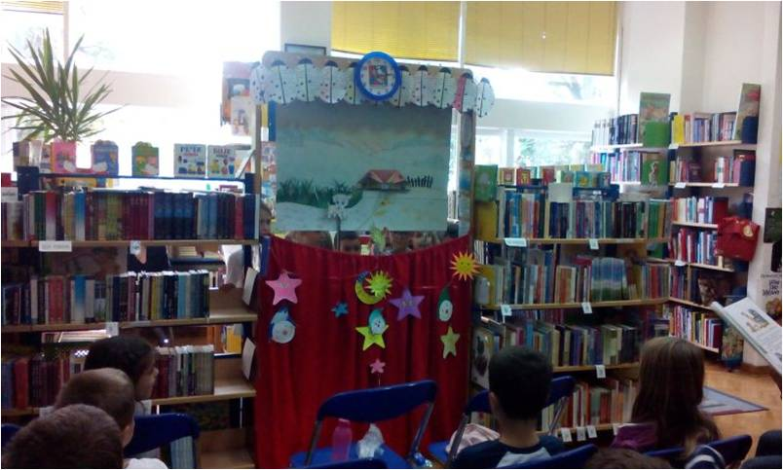
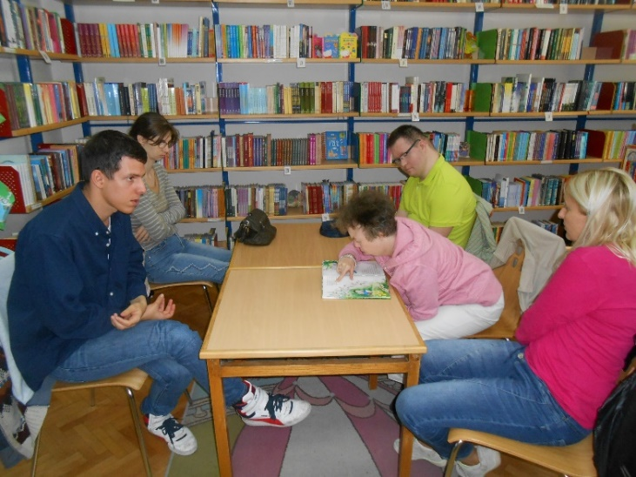
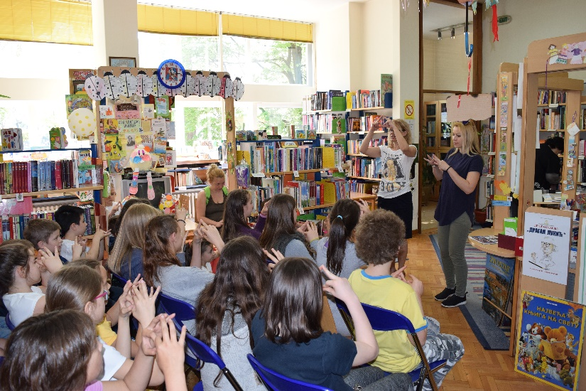
LIBRARY "PETAR KOČIĆ", VRAČAR, and ASSOCIATION "LIVING TOGETHER"; LIBRARY and HENDI CENTER "KOLOSEUM"
Storytelling workshop in a sign language
Puppet shows
Reading lessons

Slide 31
Library “Despot Stefan Lazarević,” Mladenovac
Wednesdays at 10
Center for Social Work, Mladenovac
Association for Help to Mentally Challenged Persons"Dolphin"
Center for Housing and Daycare for Children and Youth with Disabilities

Slide 32
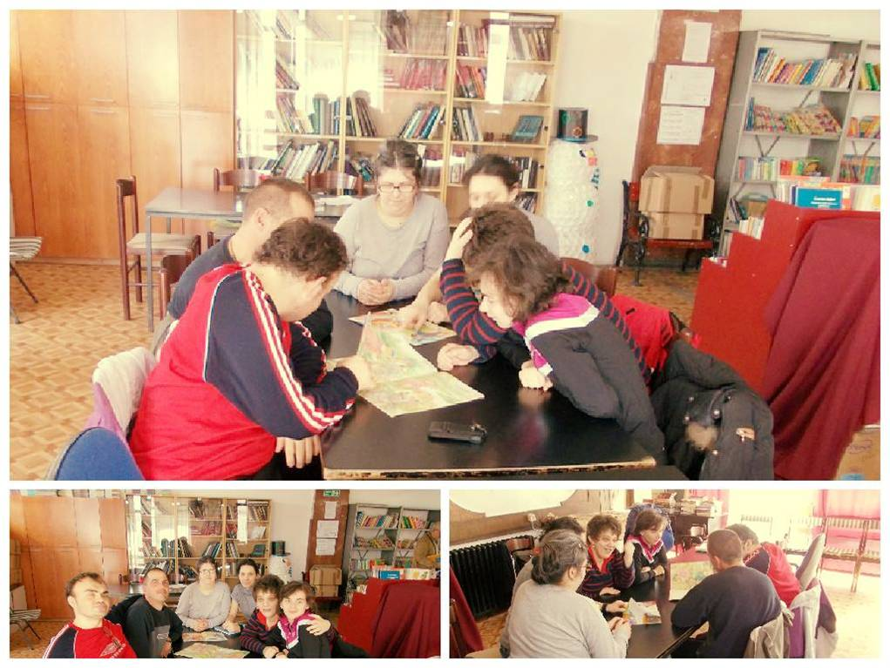
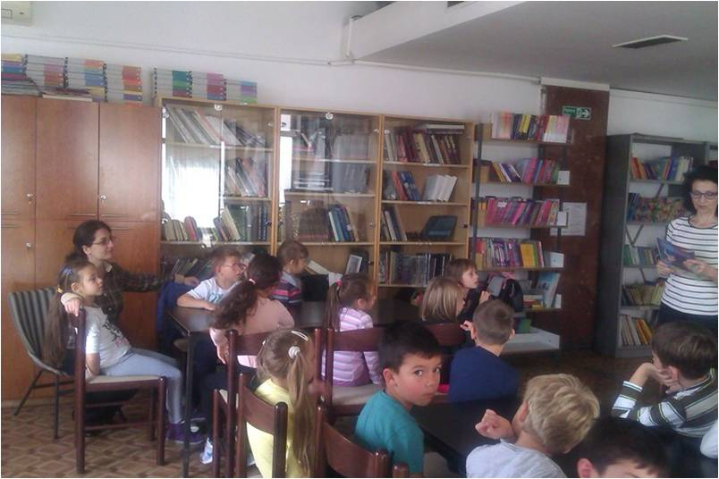
WEDNESDAYS AT 10
Let’s read
Travel with a fairy tale (developing reading habits among children, adapted school curriculum for children with disabilities)

Slide 33
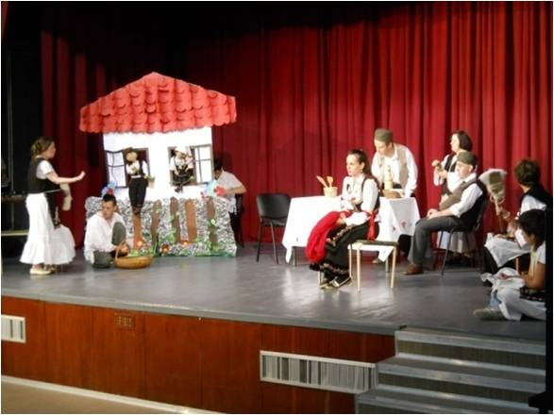
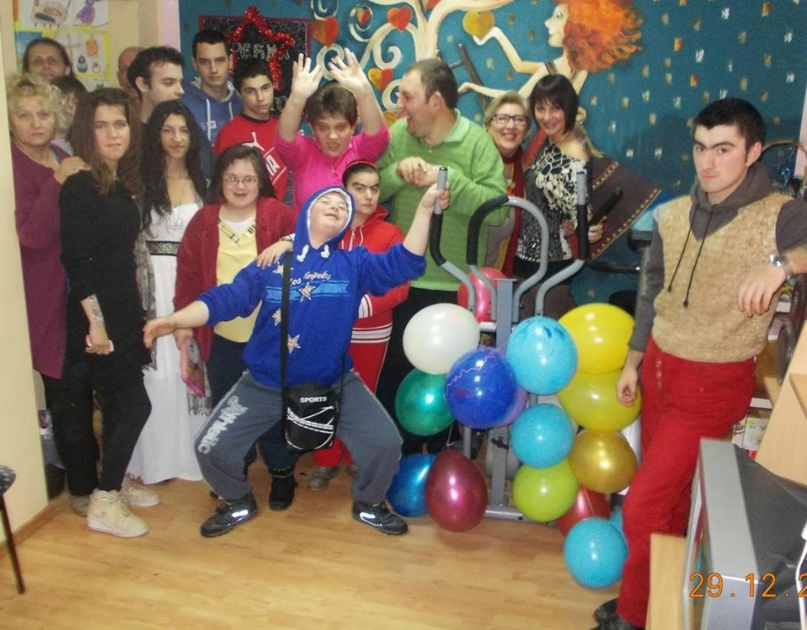
Drama workshop
Program developed for children who have a talent for acting, writing, set design, costumes, poster design and dance

Slide 34
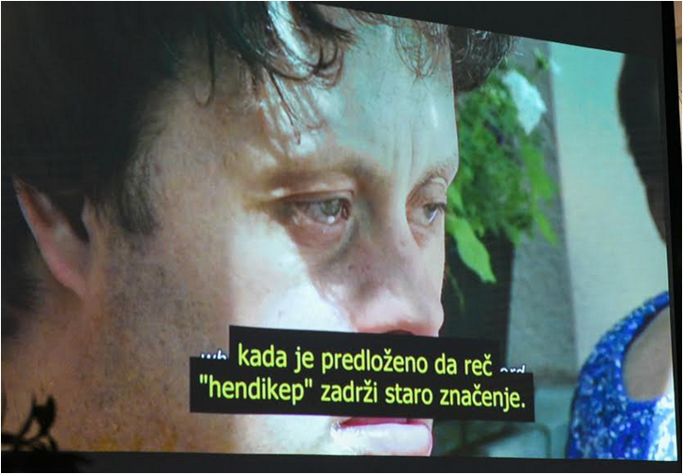
SAME IN DIVERSITY, (LIBRARY "PETAR KOČIĆ", Vračar, and HENDI CENTER "KOLOSEUM")
Workshops (education of high school students on the rights of persons with disabilities, development of a higher degree of tolerance towards persons with disabilities and their integration into society)
On the occasion of the International Day of Persons with Disabilities (December 3) program “For Life Without Barriers”–screenings of films about dissability, film by Idriss Gabel

Slide 35
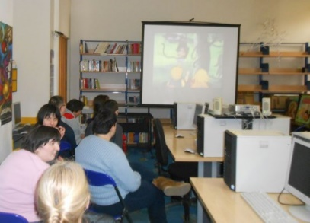
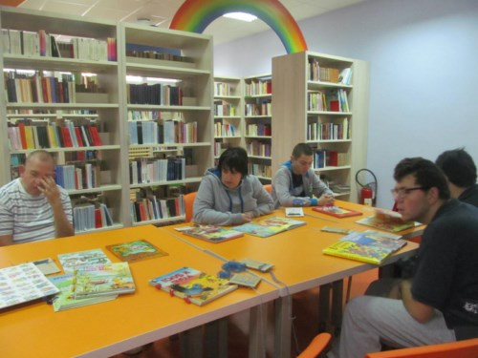
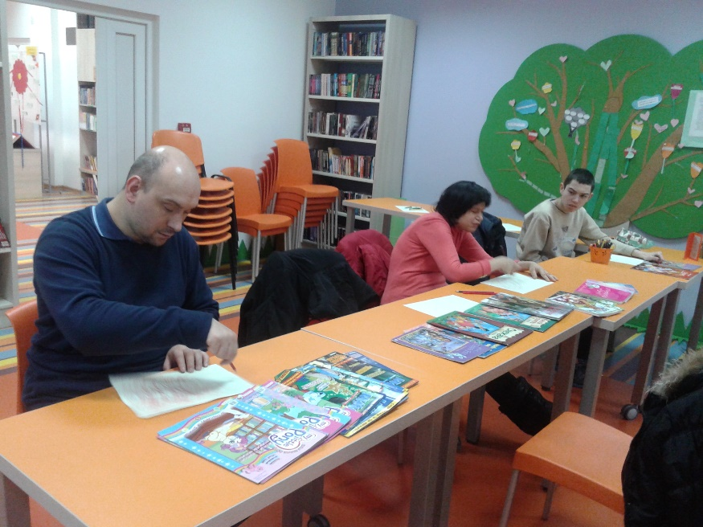
LIBRARY "PETAR KOČIĆ", Vračar, and CENTER FOR PERSONS WITH AUTISM "KORNELIJE")
Social events
(music, film screenings, CDs with children's songs, talks, art workshops)

Slide 36
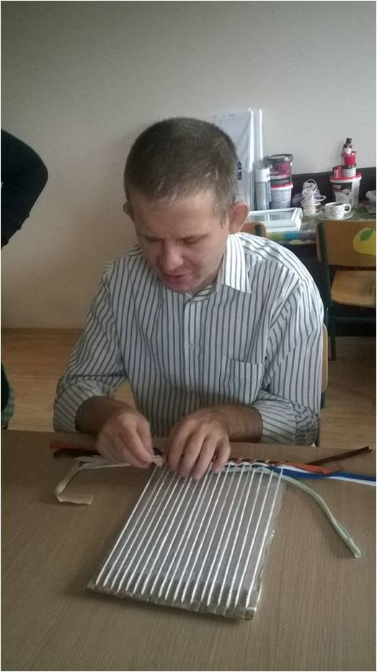
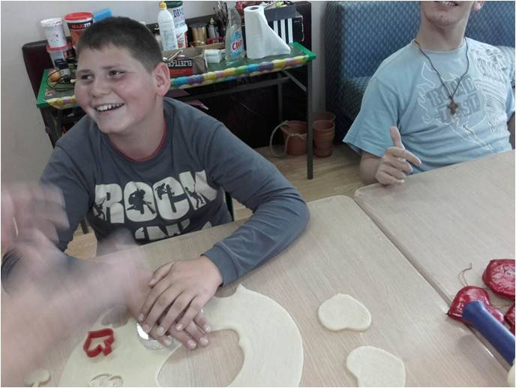
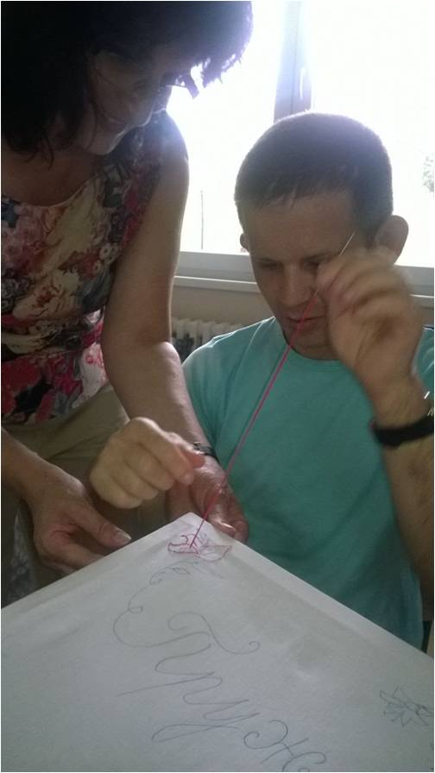
LIBRARY “JOVAN DUČIĆ”, Barajevo, and CENTER FOR HOUSING AND DAYCARE FOR CHILDREN AND YOUTH WITH DISABILITIES, Šiljakovac
Folk tradition workshops (weaving, needlework, old crafts, costume balls)

Slide 37
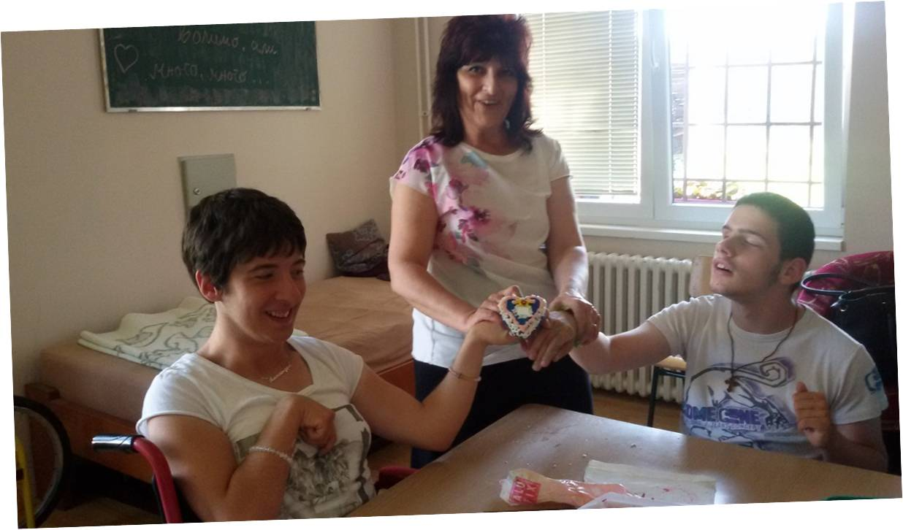
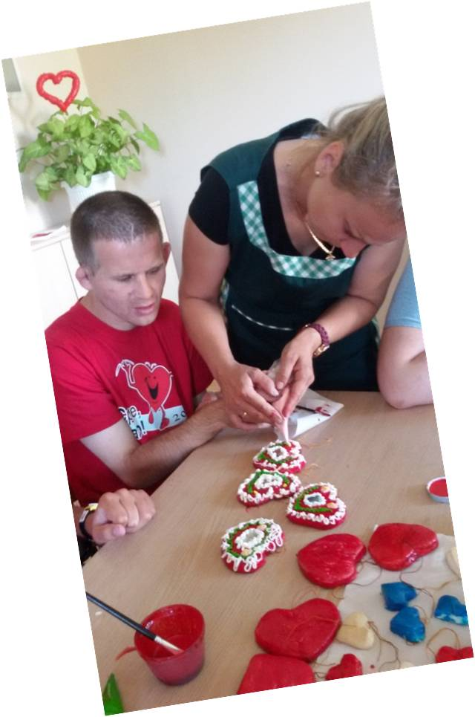
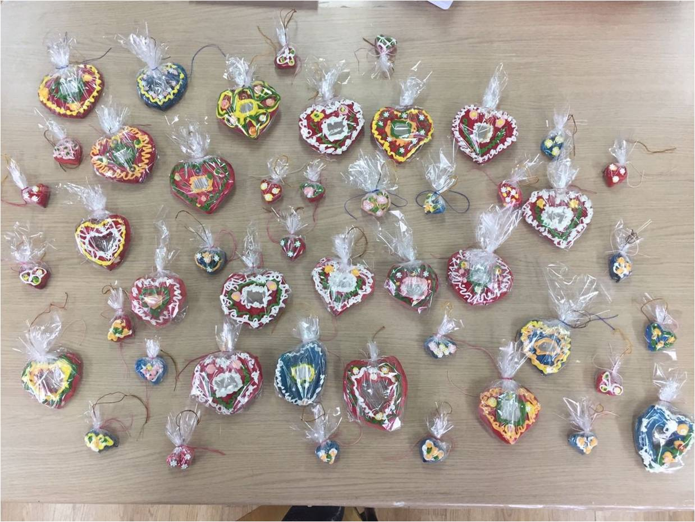
ŠILJAKOVAC
Stronger bonds between generations and with people with disabilities
Developing their creative potential

Slide 38
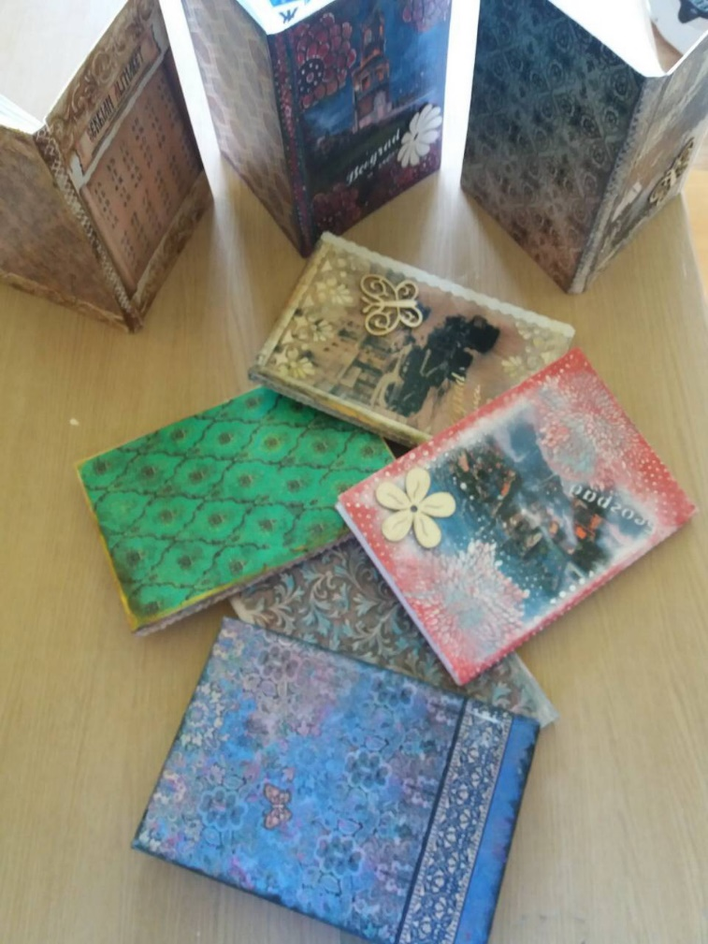
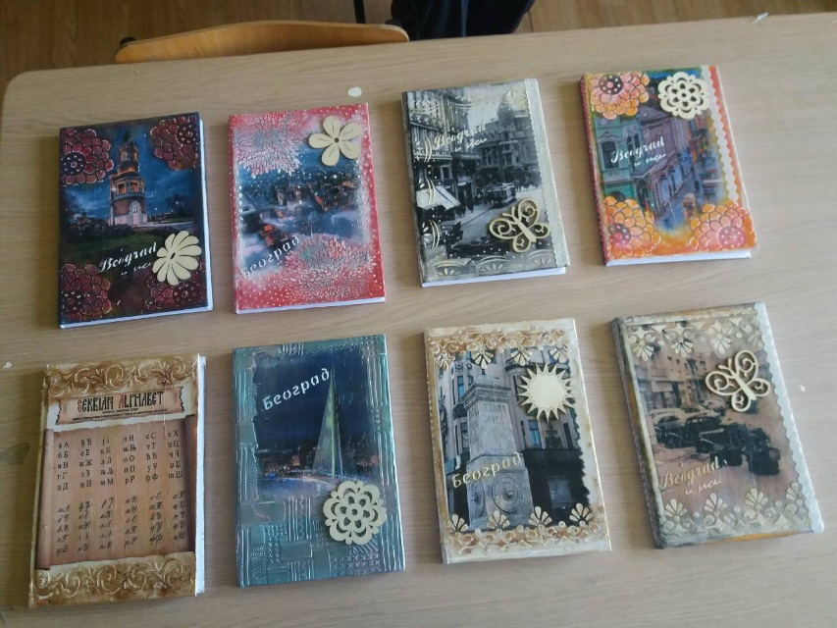
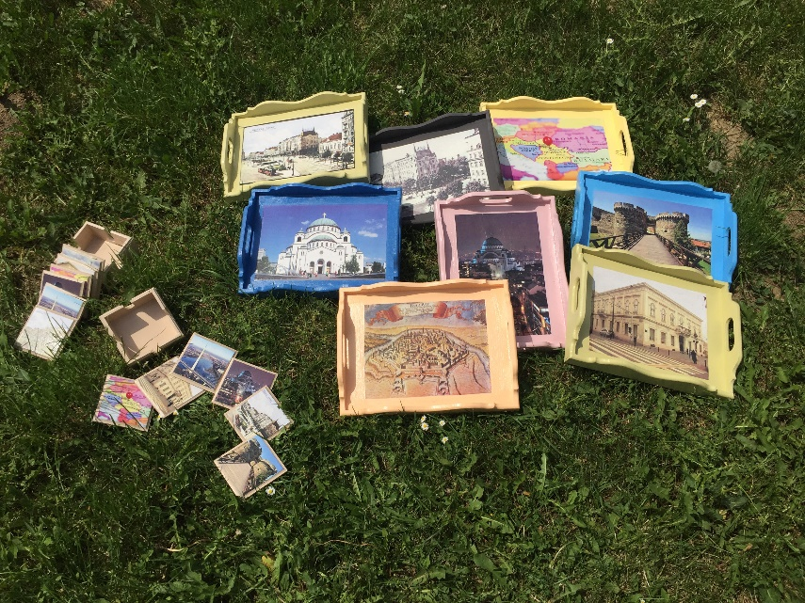
GIFTS

Slide 39
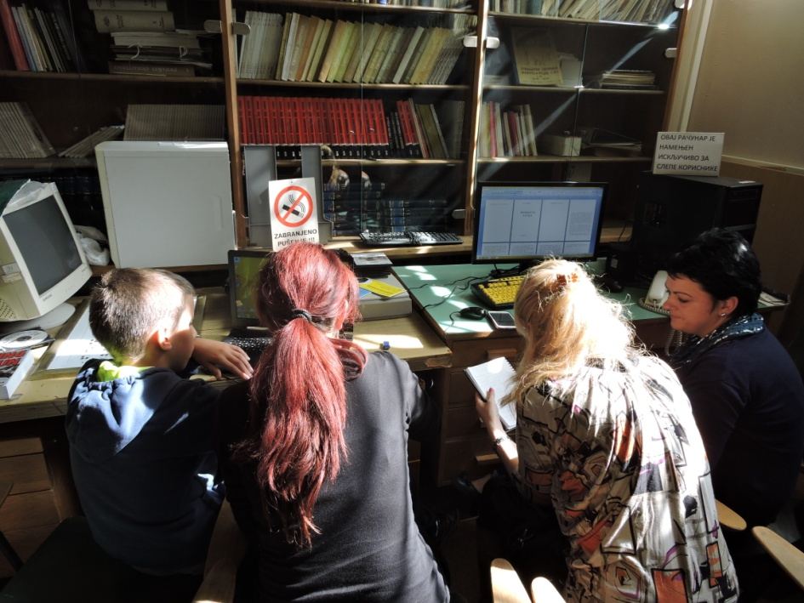
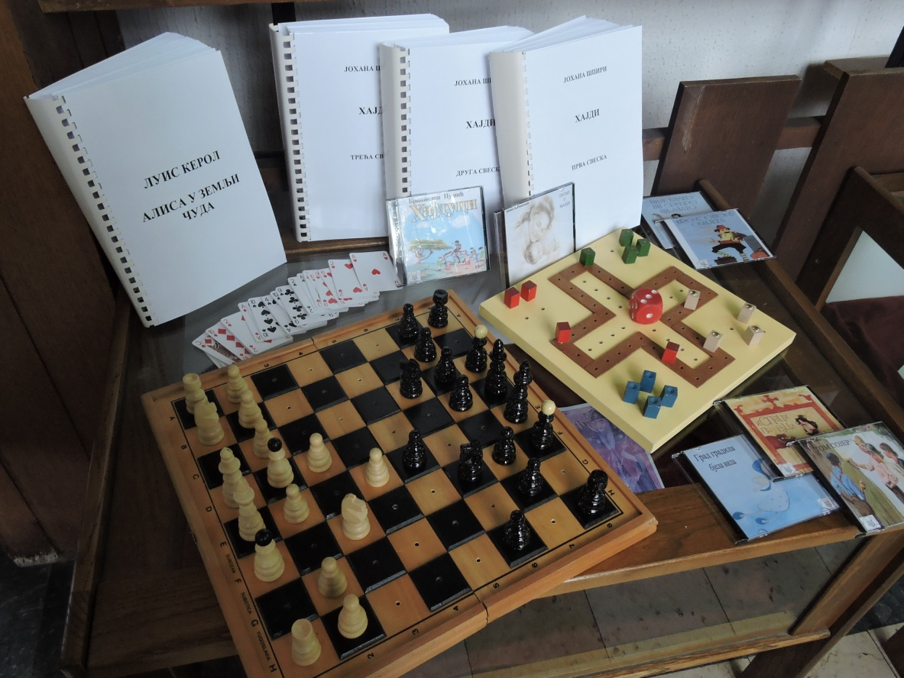
Examples from Serbia
UŽICE
Public library Užice
Project “Culture for all”
Project “Profil, anfas, Halfprofil (2012.)

Slide 40
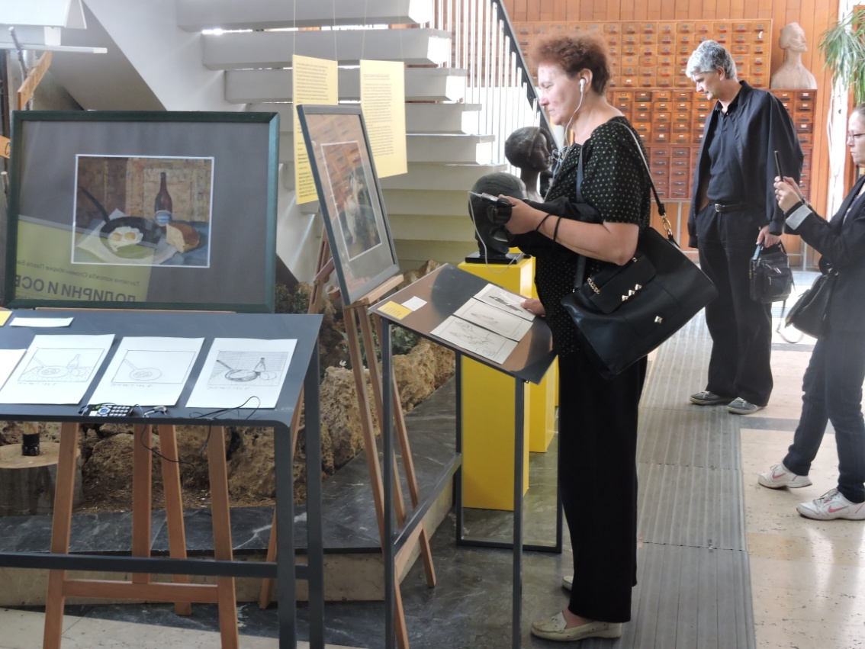

IT training Užice
Project Library service for blind persons (2014)

Slide 41

IT training
Public Library Požarevac
Special softver for blind persons ( 2010.)

Slide 42
CONCLUSIONS
Persons with disabilities are a large and often neglected part of our community, often facing economic inequity, illiteracy, cultural isolation, and discrimination in education and employment
Social integration of people with disabilities is best achieved through cultural integration
Libraries should be proactive in reaching out to persons with disabilities and facilitate their full participation in society.
Libraries promote the full inclusion of persons with disabilities into our society by becoming accessible to them (both physically and virtually)

Slide 43

Thank you

